Slide 1
Evidence of Change
Chapter 10

Slide 2
Study Design
evidence for biological evolution over time:
– the geological time scale; relative and absolute dating techniques
– the fossil record; biogeography; comparative morphology; molecular homology
determination of evolutionary relationships: comparison of DNA sequences; comparative genomics;mitochondrial DNA; phylogeny
patterns of biological change:
– allopatric speciation
– divergent and convergent evolution
– extinctions

Slide 3
Fossils
Fossils: Preserved remains or traces of an organism
Hard parts of of organisms like teeth, bones, shell
Moulds: organism has decayed away and left an exact impression in the rock
Cast: a mould that has filled with another sediment (mineral/rock)
Trace fossil: traces of the organism but not actually the organism eg footprints
It is really rare for an organism to become a fossil. Need the right conditions at the right time ie when an organism has died.
This is why the fossil record is incomplete.

Slide 4
Fossilisation Conditions
Ideally
Lacks oxygen
Or lacks water
Or lacks both oxygen and water
Mineralisation: minerals replace the bone/shell. The minerals are often harder and so it is more likely to fossilise

Slide 5
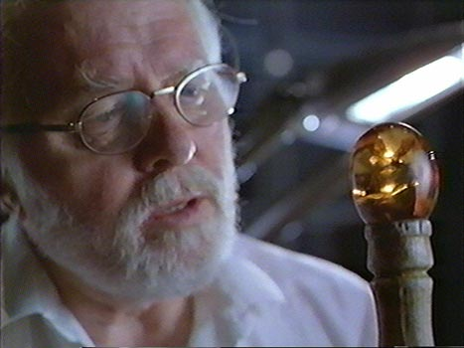
Biology rocks
The seabed which is calcium-rich ( forms limestone) has water but lacks oxygen so lots of fossils are found
Sedimentary rocks: Sand, Silt or Clay create
Generally carried by rivers and streams and deposit on ocean floor.
Originally soft materials that (won’t squish the organism) can form around the organism and then hardening.
Protects remains of organisms from scavengers
Slows decay of organism so fossilisation can occur
Amber is tree sap (liquid) which hardens over time. Think mosquito in Jurassic park

Slide 6
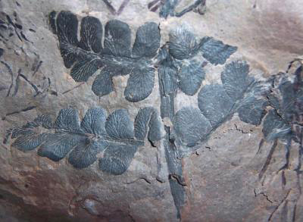
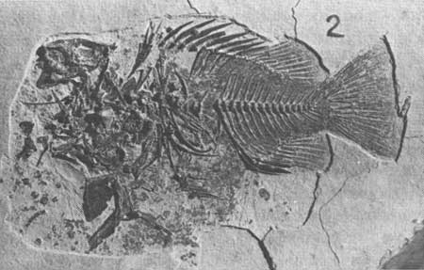
Other fossils
Impressions in rocks (leaves etc)

Slide 7
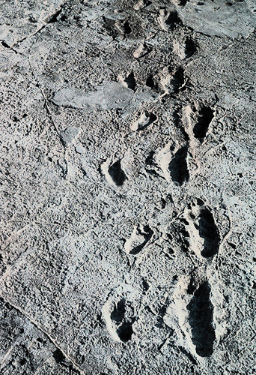
Impressions of footprints (in mud) that have been filled with volcanic ash

Slide 8
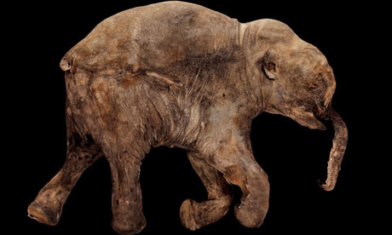
Freezing and then dehydration of an organism

Slide 9
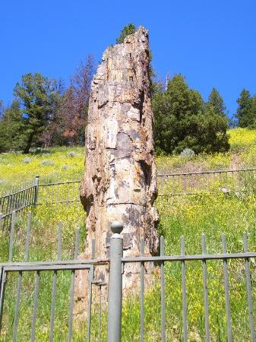
Petrification: plant material that has partly dissolved and replaced with salts that then turns to rock.

Slide 10
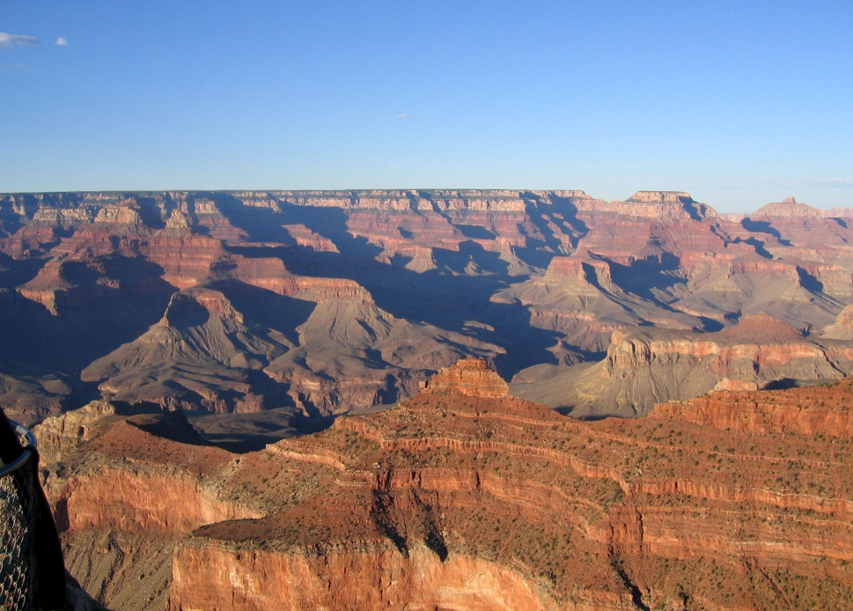
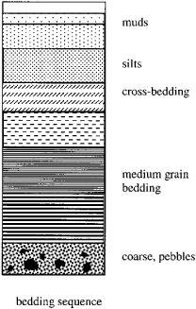
Stratification
Formation of layers in sedimentary rocks.
Sedimentary rock are composed of different sediments (rock, sand, mud etc that are transported by air or water from one place to another
Lower layers are older than upper layers
A fossil found in the lower layer will therefore be older than a fossil found an upper layer

Slide 11
Absolute dating techniques
Assigning a numerical date to a fossil, rock or biological sample
Radiometric dating
Radioactive isotopes decay or lose their radioactivity in a predictable way

Slide 12
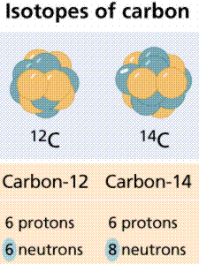
Radiodating
Some elements occur as isotopes:
Same number of protons (atomic number)
Different number of neutrons
This means a different Atomic mass (=no of protons + no of neutrons)
Some isotopes have unstable nucleus that emits energy in the form of radioactivity at a constant rate (making atom more stable)
Half life – is the time taken for half of the radioactive atoms, for that particular element, to decay.

Slide 13
Carbon-14 dating
Carbon-14 (C-14) is radioactive and breaks down at a regular rate to produce nitrogen-14
The ratio of C-14 to C-12 is constant in living things and matches the ratio of C-14 to C-12 in the atmosphere
After death, the proportion of C-14 decreases as the isotope decays (and isn’t replaced)
As time after death goes on, the propotion of C-14 to C-12 becomes smaller.
It is known that the half life of C-14 is 5730 years.
So after 5730 years, half the original amount of C-14 will have disappeared

Slide 14
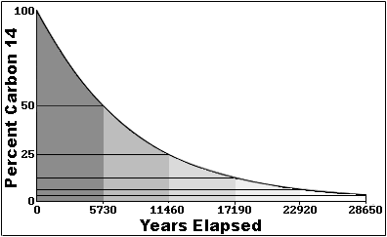

Slide 15
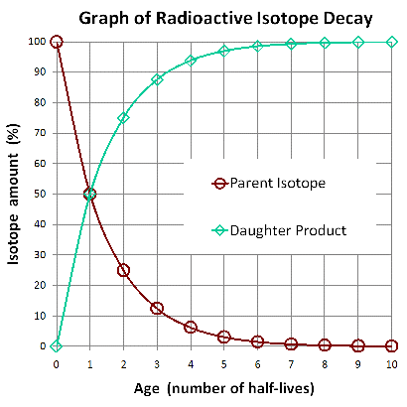
Carbon-14 dating
So if using Carbon atoms (with half-life of 5730)
After 5730 years, the decaying organism should have 50% C-14 and 50% N-14.
After 11460, the sample should have 25% C-14 and 75% N-14

Slide 16
By measuring the ratio of C-14 to C-12 in a sample of organic material, an estimate of the time since death of the organism that produced this material can be obtained.
Only useful for organic material about 12000 years old
Can be used on material up to 60000 years old but no older

Slide 17
Electron-spin Resonance (ESR)
Useful for ages from 50,000 to 500, 000 years old
When objects are buried they are bombarded by natural radiation from the soil.
When these objects are composed of minerals, this bombardment causes some of the electrons to move from the ground state to a higher energy level and some remain trapped at higher energy levels.
The longer the material has been buried, the greater the number of higher energy electrons.
Fire, heat, sunlights returns electrons to ground state.
ESR can be used to estimate the time since the object had been exposed to sunlight, fire and heat.
Measurements are taken of:
The number of high-energy electrons trapped in the material
Radiation owing to unstable isotopes
Background radiation in soil in which sample was buried.

Slide 18
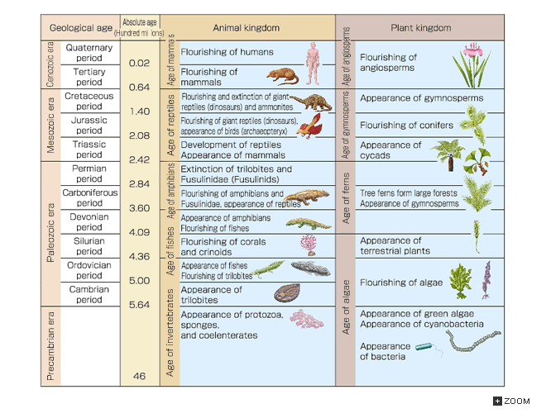

Slide 19
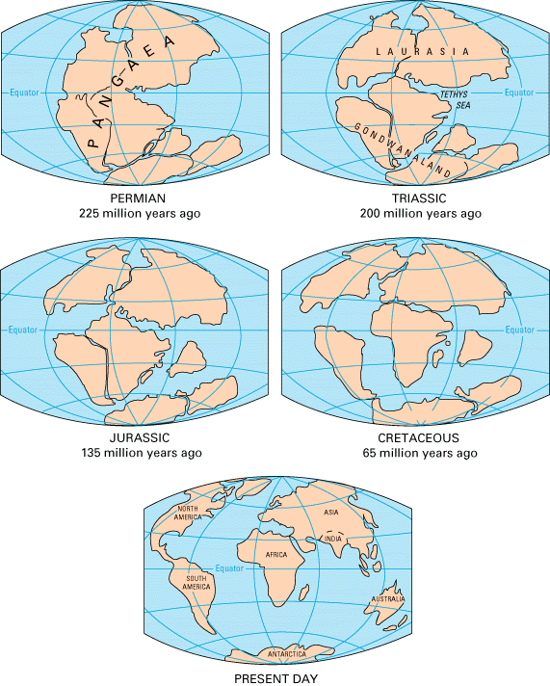
Geological time

Slide 20
Patterns of evolution

Slide 21
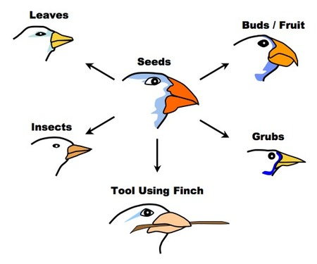
Divergent Evolution
Adaptive radiation
The process whereby organisms with a recent common ancestor develop adaptations in response to environmental pressures.
Divergent evolution
Process whereby a population of organisms with a recent common ancestor develops different adaptations as a result of changed habitats.

Slide 22
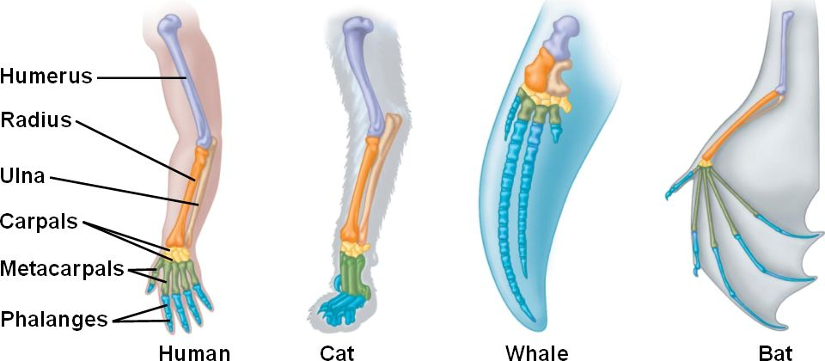
Homologous structures
Features of animals that have the same structure but different function.
Can be used to infer phylogenetic relationships.

Slide 23
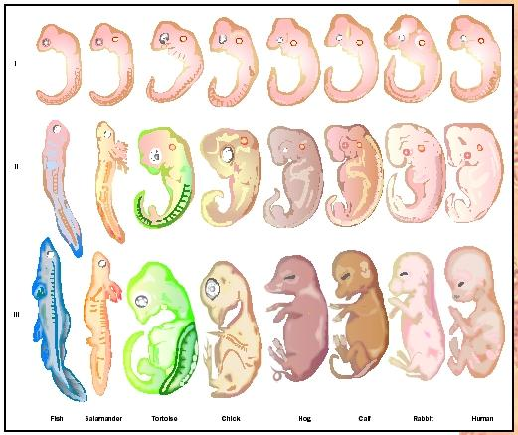
Embryology
Structural similarities and differences of embryos of different species.

Slide 24
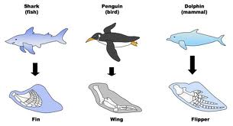
Patterns of evolution
Convergent evolution
Unrelated organisms evolve similar adaptations in response to their environment
Results of convergent evolution often show up in analogous structures. (same functions different structures)

