Slide 1
Chapter 11

Slide 2
Pre-Vocabulary
Evolution: The process of gradual change in the gene pool of a population of organisms that results in variation within a population and eventually the development of new species.
Species: a population of organisms that can interbreed and produce fertile offspring.
Gene Pool: the range of genes and alleles present in a population
Population: a group of organisms of the same species living in a particular area at a particular time.
Fossil: Any mineralised or imprinted remains of organisms or traces of organisms (scat, footprint)

Slide 3
From the study design…
a qualitative treatment of changing allele frequencies in a population and the consequences:
– the concept of the gene pool
– environmental selection pressures, gene flow, genetic drift (founder and bottleneck effects)
– natural selection as a mechanism for biological evolution

Slide 4
Allele Frequency
The abundance of any given allele in a population
Eg the allele for blue eyes in Scandinavia is more prevalent than any other allele for eye colour
When all genotypes in a population are known, we can directly count the number of each kind of allele and calculate its frequency.

Slide 5
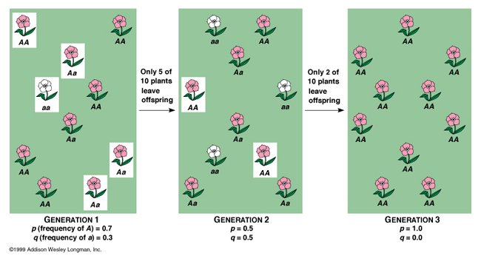
Allele Frequency

Slide 6
Constant Allele Frequency
Eg in a cat population there is white (W) cats and not all white cats (w)
If the gene pool of this population is
Freq(W)=0.4
Freq(w)=0.6
Genetic equilibrium will result if
random mating occurs – there is no preference to mating based on coat colour.
Population is large
Phenotypes in the population survive equally well
Mating produce the same number of viable off spring
No migration into or out of the population occurs.
Under these conditions, the population is said to be in Hardy-Weinberg equilibrium
The allele frequencies in the population will stay the same over generations.
Note that it is rare for all of these conditions to occur at once.

Slide 7
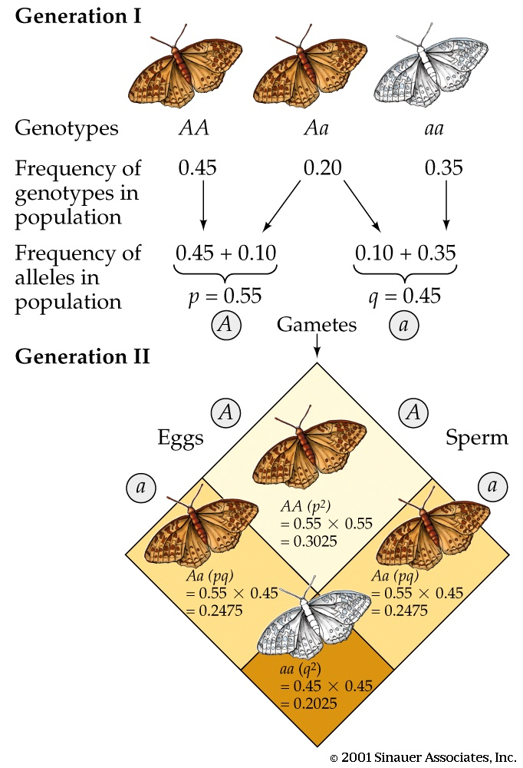
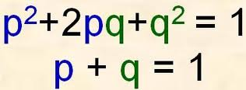
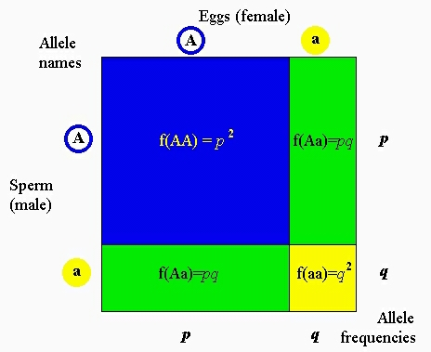
Hardy weinberg equilibrium

Slide 8
Factors that change Allele frequency
Allele frequency can remain constant over time, but may be affected by some factors
Mortality of individuals carrying a specific allele eg albino animals in the wild can’t camouflage
Emigration of individuals carrying a specific allele. (maybe warmer coated animals will move to cooler region)

Slide 9
Variation is due to four forces of gene pool change
Mutations in germ line cells: A random process which generates new allele types.

Slide 10
Variation is due to four forces of gene pool change
Genetic Drift: a random force leading to allele extinction. Involves chance / random mating between members of a population.
A significant force for change in small populations.
Related processes: Bottleneck / Founder Effects

Slide 11
Variation is due to four forces of gene pool change
Gene Flow or the transfer of genes between populations:
Non-random force in which migrating individuals add or remove alleles from any given population due to leaving or joining a population.

Slide 12
Variation is due to four forces of gene pool change
Selection: A non-random force that matches local environmental conditions with specific phenotypic varieties.
This shapes allele frequencies in a population through the different reproduction rates of different members of the population.
A powerful force in larger populations
(Can be artificial selection in breeding stock)

Slide 13
An allele associated with a higher reproduction rate will change the allele frequency
Allele associated with immigration: organisms that are able to fly/run for longer periods will integrate with new groups of the species (in far away places).
Chance eg a colour blind woman having ten children. Each child would inherit at least 1 allele for colour blindness increasing the allele frequency

Slide 14
Gene flow
Changes in the allele frequencies of a population due to physical movement of alleles in or out of a population
Immigration and emigration

Slide 15
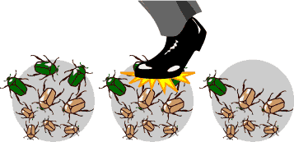
Genetic Drift
Changes that are unpredictable in direction, in allele frequencies from one generation to the next owing to the action of chance events

Slide 16
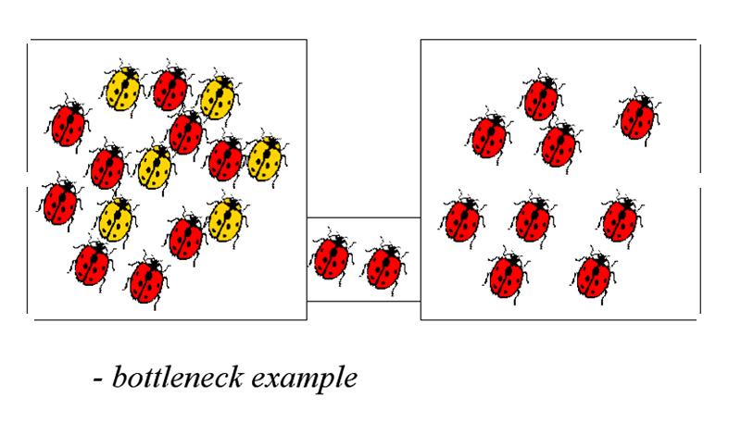
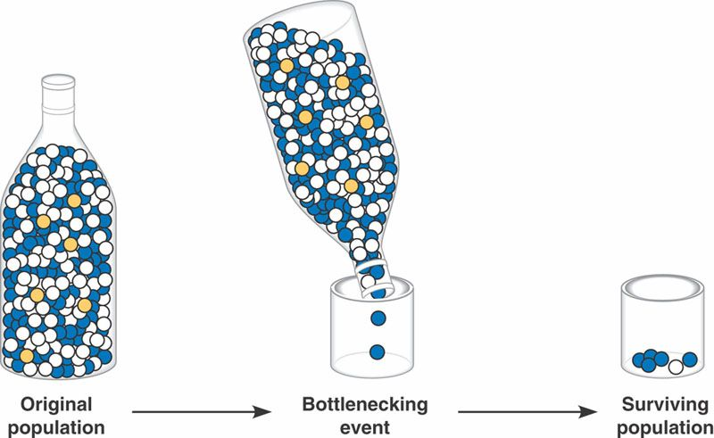
Bottle Neck
Selection pressure can bring about a severe reduction in population size.
Contagious disease, loss of habitat, hunting, volcanic explosion
If only a few individuals of a population survive than only their alleles survive. This may mean some alleles are lost.

Slide 17
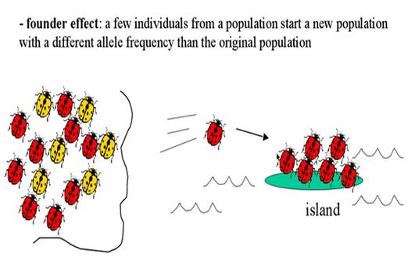
Founder Effect
A few individuals of a population leave to start a new population else where.
The allele frequencies of the founders may not be the same as those of the original population and selection pressures in a new habitat may favour different phenotypes.

Slide 18
Peppered moth example
http://www.techapps.net/interactives/pepperMoths.swf

Slide 19
Theories of Evolution
Lamarck
Traits are passed from parents to offspring
If a parents trait is changed during their lifetime than this would be passed to offspring
Eg. If you cut a mouses tail off, its offspring will not have a tail
This theory was disproven (the baby mouse did have a tail!)

Slide 20
Theories of Evolution
Charles Darwin and Russel Wallace
Natural Selection or ‘survival of the fittest’
The differences between individuals determine how well they will survive
Traits that increase the possibility of an organisms survival are passed on to their offspring.
Organisms that are best suited to their environment will survive and pass their characteristics to their offspring. Those that aren’t suited won’t survive and won’t have oppring so their unfavourable characteristics won’t get passed on.

Slide 21
Support for the Theory of Evolution
Geographic evidence:
similar fossils found in similar environments
relationships between fossils in strata at same locations
plate tectonics, continental drift and fossil locations

Slide 22
Aging fossils:Relative Dating ( layers of rock and the fossil record)

Slide 23
Absolute Dating (radioactive isotope decay)

Slide 24
Environment Data (what was possible and when: gasses present in atmosphere and the fossil record)

Slide 25
Structural features: comparative anatomy (can be misleading evidence)

Slide 26
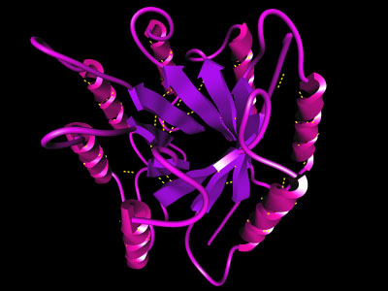
Biochemical Differences: DNA sequences and hybridisation, Proteins (haemoglobin)

Slide 27
Evidence by Example: Short Life Cycle Organisms
Virus mutations / Bacterial resistance
Selective breeding in agriculture (crops or stock)

Slide 28
Natural selection
Individuals differ from one another (that is they show variation)
Offspring generally resemble their parents
More offspring are born than can possibly survive to maturity and reproduce
There is a struggle for existence with some individuals being better suited to their environment than others.

Slide 29
Speciation
A species is a group of organisms that normally interbreed in nature to produce fertile offspring. The formation of a new species is called speciation.
Generally occurs over long periods of time and cannot be seen in a human lifetime.

Slide 30
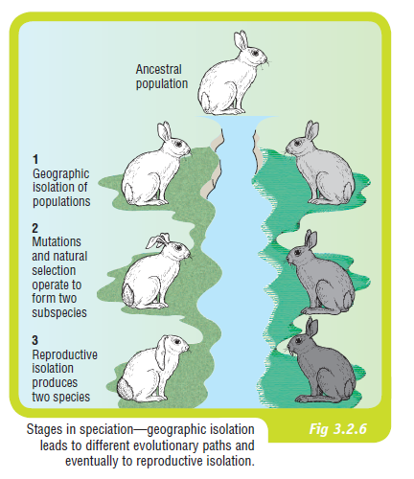
Pre-reproductive isolating mechanism of Speciation
Geographical isolation
Or Allopatric speciation
Group of organisms physically and geographically isolated into two or more groups
Seperated by water, land, moutains, continental drift, climate change
Will now experience different environmental pressures that will influence natural selection weather conditions, food, habitat etc

Slide 31
Pre-reproductive isolating mechanism of Speciation
Natural selection
Over many generations
Together with some genetic mutations, each group may develop own characteristics and become a subspecies (appear different but can still interbreed)

Slide 32
Pre-reproductive isolating mechanism of Speciation
Reproductive isolation
Can’t interbreed and thus are a new species
Reasons include
Can’t recognise each other (mates)
Change in genitalia
Change in mating habits and behaviours
Seasonal difference in mating

Slide 33
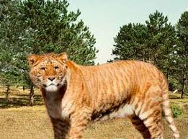
Post-reproductive isolating mechanisms of speciation
Mating is not prevented from occuring, but offspring are not produced
Gametes do not survive
Zygote forms but does not survive
Hybrid sterility: Adult offspring are formed but are infertile because they can’t produce viable gametes (lion x tiger = liger which is sterile

Slide 34
Example: Salamanders in California
https://www.youtube.com/watch?v=YCoEiLOV8jc

Slide 35
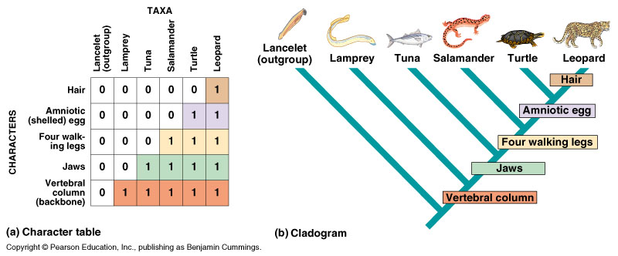
Evolutionary Relationships
Can be represented as phylogenetic trees based on
Structural information about the organism (see figure 11.20)
Biochemical information such as DNA comparisons.

Slide 36
Evolutionary relationships
Molecular
DNA sequencing
DNA-DNA hybridisation
DNA is extracted from different species being analysed. Heated to seperated strands,
Cut using restriction enzymes into small peieces
The two species restriction digests are then mixed and allowed to cool
As they cool, fragments collide and reform bonds.
Greater the number of bonds that form between the fragments, the stronger the binding.
So if the fragments are then reheated to separate strands, scientists can tell how strong the bonds are by how much heat is required to be applied.

Slide 37
Evolutionary relationships
Molecular
Mitochondrial DNA
Single circle of DNA
Only comes from mothers ova (not inherited by father)
Mutates at a steady state
Scientists can compare the amount of mutation between different species to determine when they might have had a common ancestor.

Slide 38
Evolutionary relationships
Molecular
Proteins
Protein structure depends on amino acid sequence (which in turn depends on DNA sequence). Thus differences in protein structure can be used to determine evolutionary relationships.

Slide 39
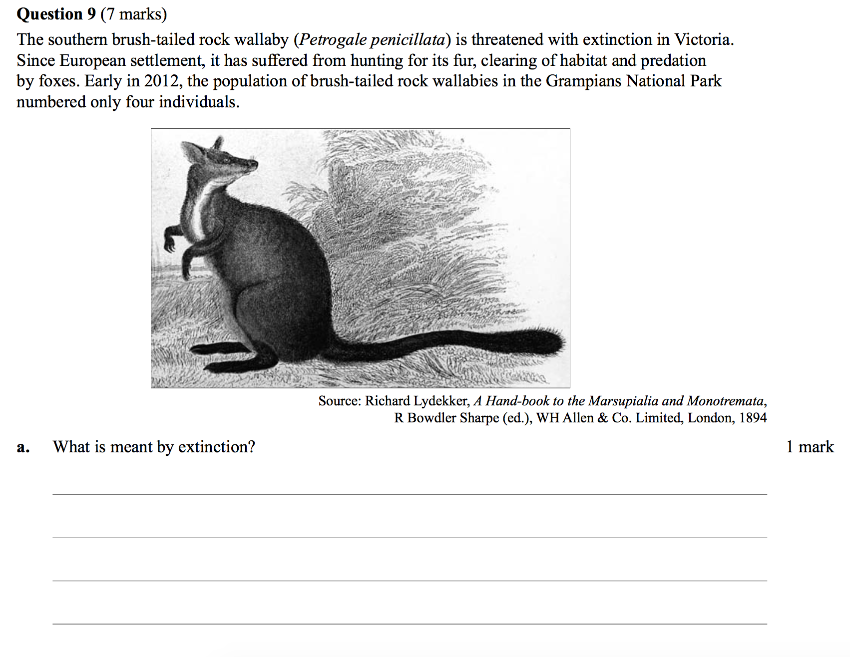
Questions

Slide 40
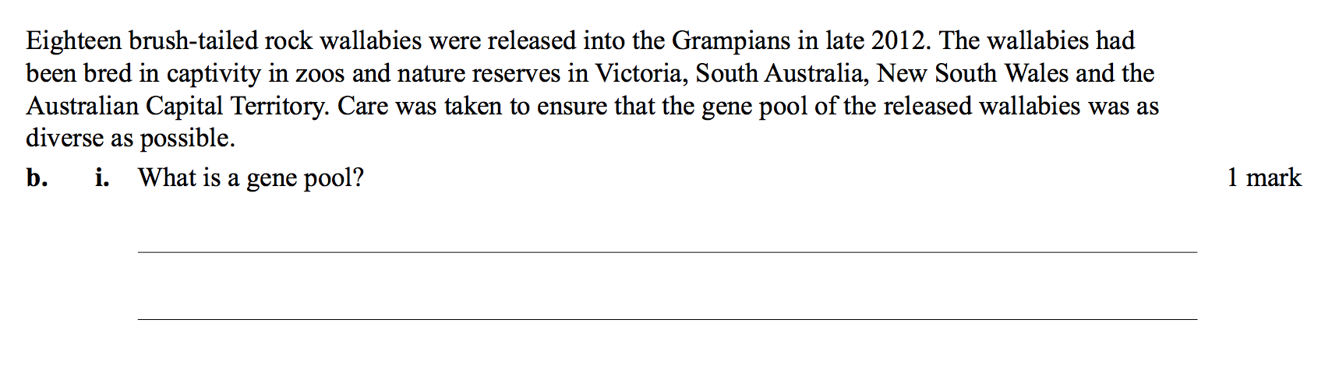
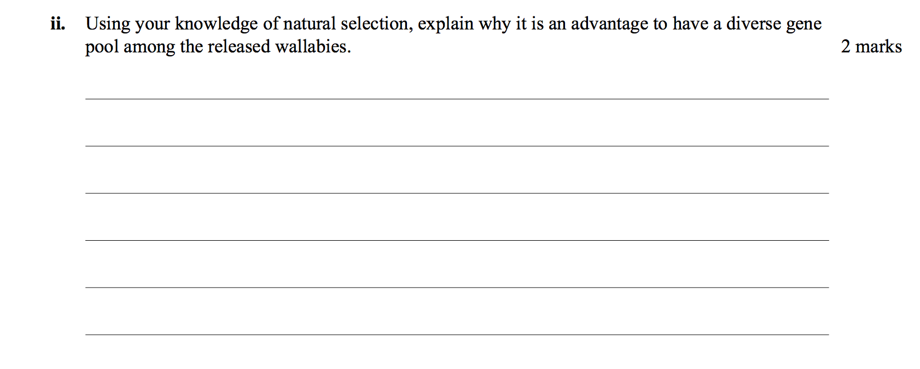

Slide 41
