Slide 1
Hominin Evolution
Chapter 12

Slide 2
From the study design
Hominin Evolution
Shared characteristics which define primates, hominoids and hominins
Major trends in hominin evolution from the genus Australopithecus to the genus Homo including morphological, structural and cognitive development resulting in cultural evolution and rise of technologies.

Slide 3
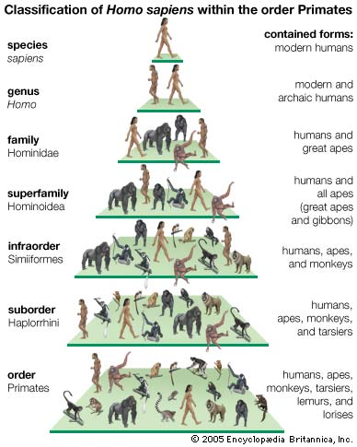
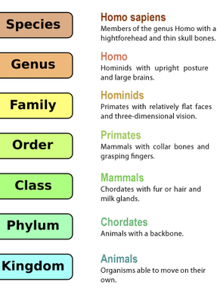
Classification of the Human Species
Know these ones

Slide 4
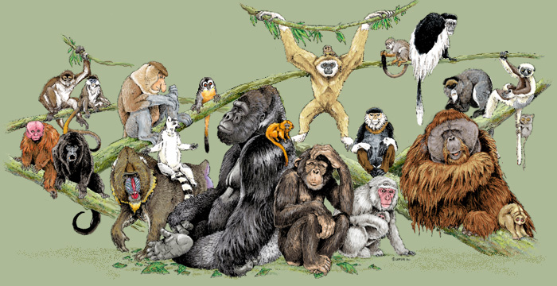
Order: Primates
Fossil evidence shows that early primates probably evolved 90 – 100 million years ago.
Early ancestors probably migrated across Gondwana and after the super continent split up, divergent evolution continued giving rise to various monkeys and apes.
In Africa, another branch of primates arose, which are all extinct today except one species – Homo Sapiens.

Slide 5
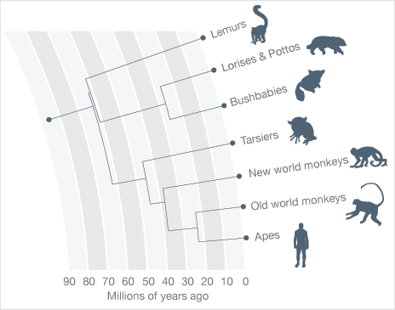
Prosimians
Spider monkeys
Baboons and macaque monkeys
Anthropoids
Gibbons, orang utans, gorillas and humans
What difference can you see between ‘new world apes’ and ‘old world apes’?

Slide 6
Old world vs new world
What difference can you see between ‘new world apes’ and ‘old world apes’?
Ability to live in trees vs live on ground.

Slide 7
Evolution of Primates
All primates living today gradually evolved over a period of at least 65 million years from ancestral primates that were probably small tree-dwelling mammals.
They were able to migrate across the remnants of gondwana land. When Gondwana land split up, divergent evolution continued giving rise to various species of monkey we know today
65MYA
Humans diverged from the African apes line about 5 to 7 million years ago. That is, humans last common ancestor with apes lived about 5 to 7 million years ago.
40 MYA
31 MYA

Slide 8
Tarsier position on phylogenetic tree controversy…
One of the most disputed issues in primate evolution and thus of our own primate roots, is the phylogenetic position of the Southeast Asian tarsier. While much molecular data indicate a basal place in the primate tree shared with strepsirrhines (prosimian monophyly hypothesis), data also exist supporting either an earlier divergence in primates (tarsier-first hypothesis) or a close relationship with anthropoid primates (Haplorrhini hypothesis). The use of retroposon insertions embedded in the Tarsius genome afforded us the unique opportunity to directly test all three hypotheses via three pairwise genome alignments. From millions of retroposons, we found 104 perfect orthologous insertions in both tarsiers and anthropoids to the exclusion of strepsirrhines, providing conflict-free evidence for the Haplorrhini hypothesis, and none supporting either of the other two positions. Thus, tarsiers are clearly the sister group to anthropoids in the clade Haplorrhini

Slide 9
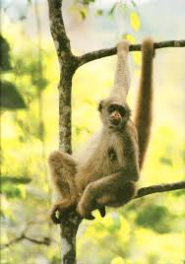
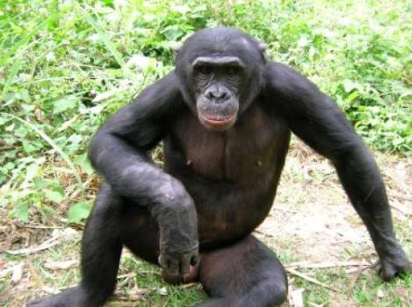
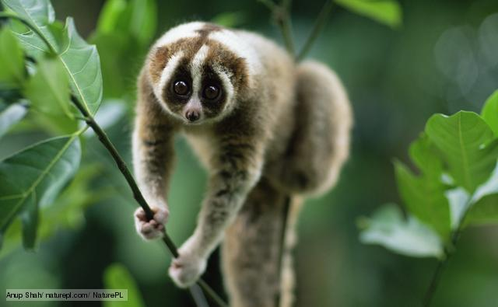
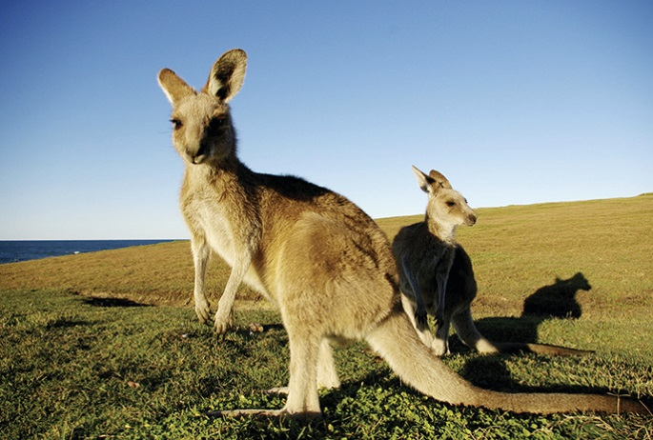
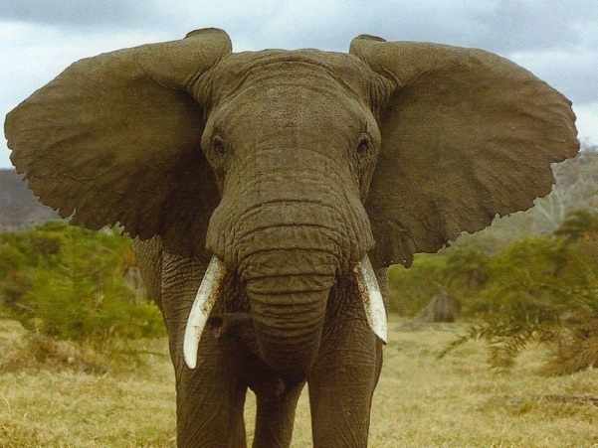
Adaptive features of primates
In groups of 3 or 4
Consider the following mammals comparing primates and animals part of other orders
brainstorm and describe features of primates that provide them with an adaptive advantage.

Slide 10
Primate identifiable features
Hands and feet:
Five digits that can grasp or curl around objects and thumbs (sometimes big toes) that are opposable ( can bring in contact with other fingers
Flat nails on their digits
Tips of digits have many touch receptors
Vision
Large forward facing eyes that give 3D vision
Colour vision (3 different types of cone in their retinas)
Protective cone at the outer side of the eye socket
Skeleton is flexible for life in the trees (can rotate the arm in the shoulder socket)
Large brains compared to body size
Social animals - live in groups (pairs to hundreds!)
Long gestation period compared to non-primate mammals (allows brain to develop). Typically produce a single child at each birth and provide parental care for an extended period of time.
See table on page 367 for more.

Slide 11
SuperFamily: Hominoidea
Hominoidea
superfamily
Hylobatidae
Hominidae
Family
Ponginae
Gorilinae
Homininae
SubFamily
Panini
Hominini
Tribe
Hylobates
Gibbons, Siamangs
Pongo
Orang-utans
Gorilia
Gorillas
Pan
Chimps
Homo
Humans
Genus

Slide 12
Hominins
At this classification humans are separated from other apes
Able to walk erect on hind legs.
Bipedal (two footed) locomotion
Humans (Homosapians) are the only modern Hominin. All other known hominins are extinct.

Slide 13
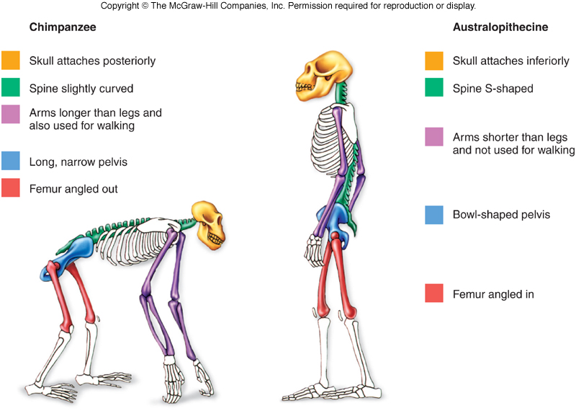
Evidence of erect/bipedal walking in Fossils
Fossilised footprints from 3.6 MYA have also shown feet similar to ours without the big ape like toe.

Slide 14
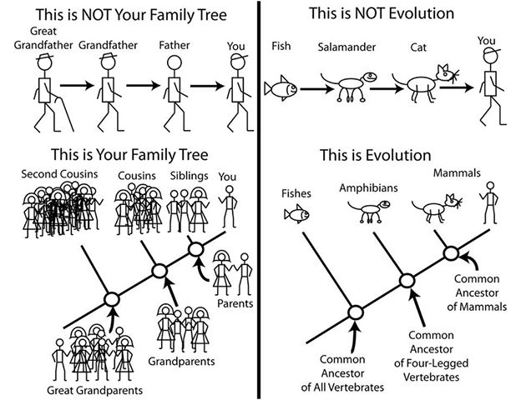
Point:
Humans did not evolve from chimps. We just shared a common ancestor.

Slide 15
Advantages of bipedalism
Free hands for carrying things, doing things while moving
Move faster than when using all four limbs
Able to scan for predators more easily.

Slide 16
Divergence of humans from other hominins
Development of language
Tool making and using
Use of fire for cooking
Social life (coorerative hunting, gathering, sahring information, child care)

Slide 17
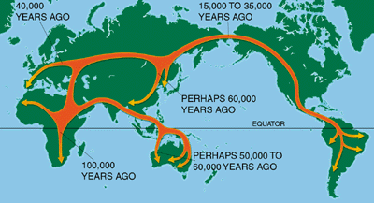
Out of Africa model
Suggests:
Humans originated from africa 100,000 years ago and spread throughout the world
Check out picture on page 376 of your text – its much better
Theory based on mitochondrial DNA analysis
Suggests a lineage of African females migrated across the world.
Also known as the ‘Eve’ theory due to all coming from one female.

Slide 18
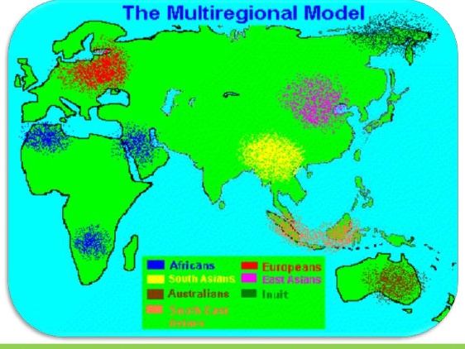
Multiregional theory
Humans evolved independently in many regions of the world
Originating in Africa, Europe, Eurasia and South-East Asian

Slide 19
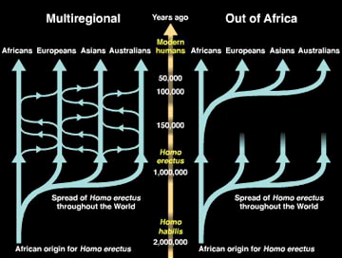
Eve vs Multiregional

Slide 20
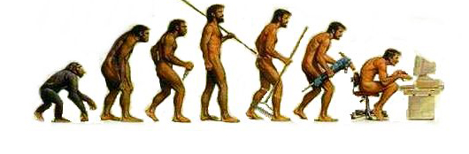
Cultural evolution of Man
Larger brains meant that Homo species could develop in a greater social capacity
Sophisticated language
Tools
Societal expectations

Slide 21
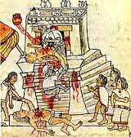
Two complex and uniquely human traits emerged:
Religious rituals
Burials

Slide 22
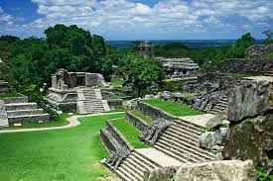
Best described with an Example: The Mayan Empire

Slide 23
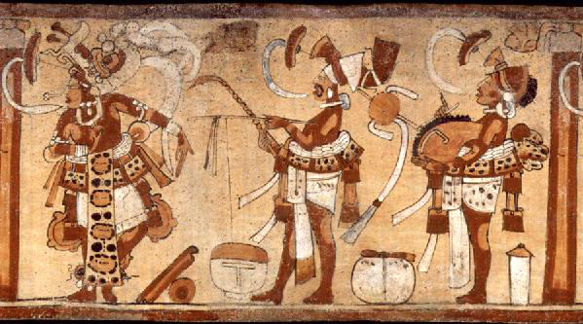
A classic example illustrating the success and failure of a culture to adapt to varying environmental conditions is the collapse of the Maya. The Maya were a precolumbian society living in Mexico and Central America about 1000 years ago. In the early stages of their society, the Maya consisted of many small villages that exploited local plant and animal resources, and used small-scale agriculture to provide food for each village. Some trade existed between villages for luxury items, special crafts, and raw materials, but the villages were only loosely organized through these economic ties.
Eventually, through the application of military power and an organized religion, many villages were united under the control of a central government, and the Maya society experienced a period of rapid growth. They developed a large population, with a centrally controlled government which managed much of the society through religious and economic controls.

Slide 24
Their society was very successful and reached a level of homeostasis, or equilibrium, between their cultural system and their environmental system. Through the use of large-scale agriculture (farming), they produced enough food to feed the large population. State and religious control of this system served to manage these resources efficiently, and military success also brought in new resources from outlying communities.
After several hundred years, as the population continued to increase, it reached the environmental carrying capacity. Carrying capacity is the maximum number of individuals for which the environment can provide enough limiting resources. Limiting resources may be anything in short supply, such as food, water, territory, or any other essential resource. The Maya went beyond their environmental carrying capacity, buoyed by the highly efficient but rigid cultural institutions of state controlled agriculture, the military, and organized religion.

Slide 25
Eventually, after a period of environmental degradation, such as series of droughts and subsequent crop failures, the conditions that the Maya society were adapted to changed, and the environment was no longer as predictably bountiful for an agricultural society. The cultural institutions did not react (adapt) quickly enough, resulting in a collapse of the entire cultural system.
After a period of rapid loss of population through famine, disease, and warfare, the central government collapsed, and Mayan society went back to its earlier state consisting of many small villages who still utilized agriculture, but only for the local production of food. These small villages were more flexible and better able to adapt and adjust behaviors to take advantage of available local resources. The Mayan cultural system still exists today in this form, undergoing another period of homeostasis.

Slide 26
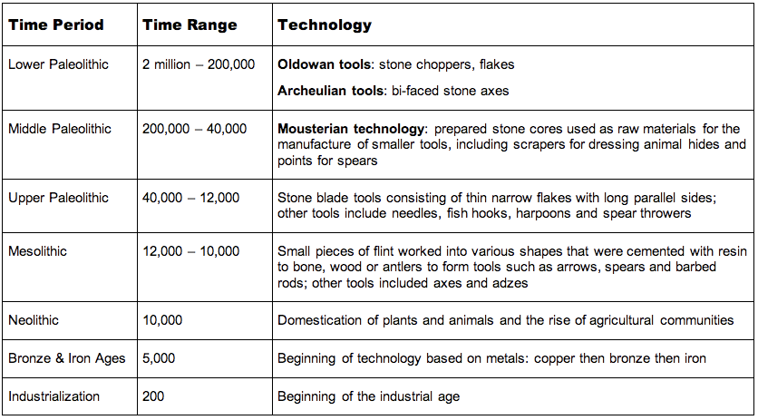
Timeline

Slide 27
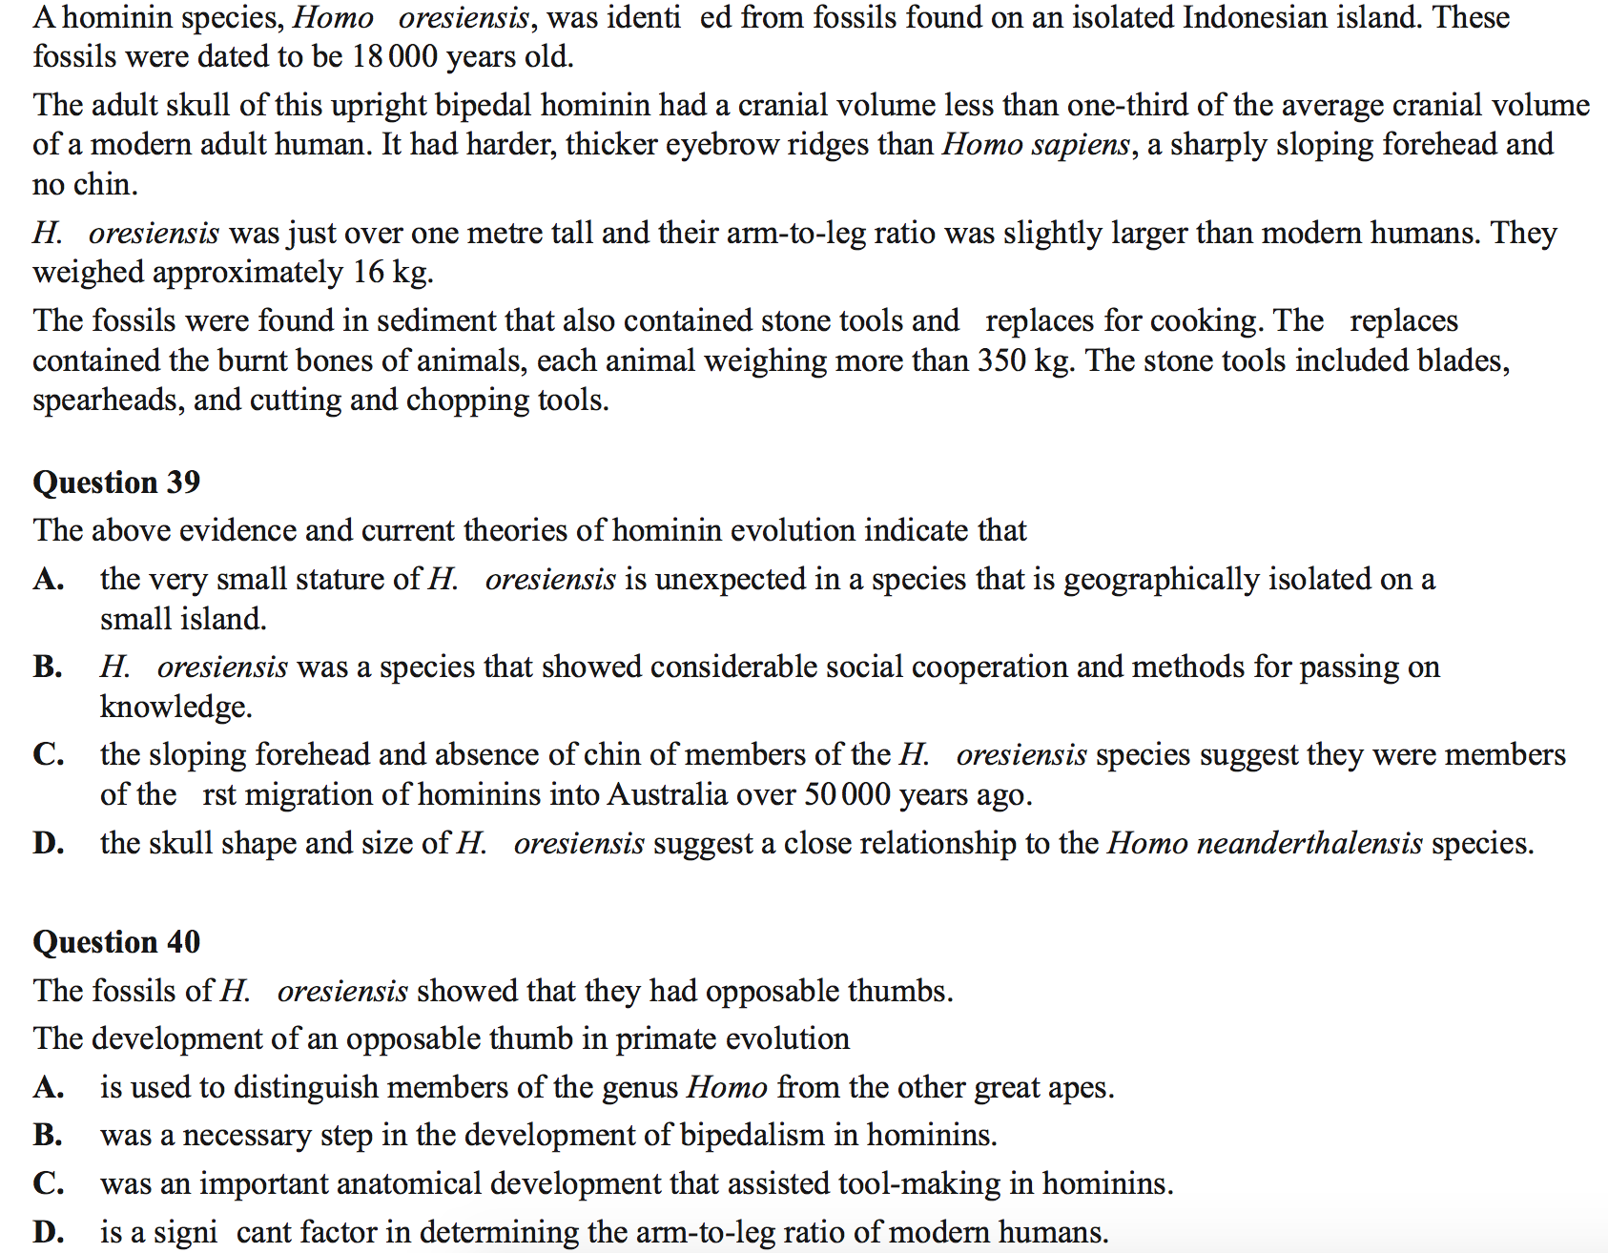
2014 VCE Exam

Slide 28
