Slide 1
Chapter 7

Slide 2
Vocab
Genetics
Bioinformatics
Heredity
Genes
Karyotype
Chromosome
Homozygous
Heterozygous
Autosome
Heterosome
Gamete
Independent assortment
Trait
Locus/Loci
Allele
Pure-breeding
Monohybrid
Generation (P, F1, F2)
Dominant
Recessive
Genotype
Phenotype
Dihybrid
Pedigree analysis
Carrier

Slide 3
DNA Replication
See Crash Course Biology
Class quiz:
http://www.hartnell.edu/tutorials/biology/dnareplicationquiz/dnareplicationquiz1.html

Slide 4
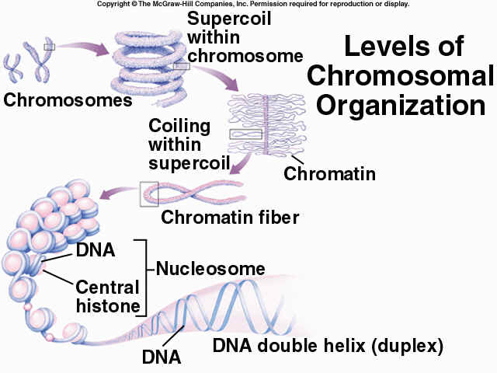
Chromosomal Structure
DNA is packaged into tightly tangled chromatin
During nuclear division, DNA appears as double structures coiled around histone proteins and linked at the centromere
Chromosomes are only visible during cell division when stained.

Slide 5
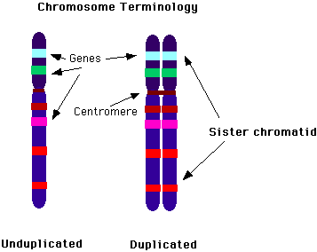
Chromosomal Structure
Chromosomes consist of segments that code for particular genes – the location of a gene segment is a locus (loci = plural)
Sister chromatids will have the same loci as each other

Slide 6
Chromosomal Structure
Genes found on loci code for particular traits.
These traits can be found in different forms, alternative forms of the same gene are called alleles.
EG Human rhesus blood type alleles can be found to code for positive or negative

Slide 7
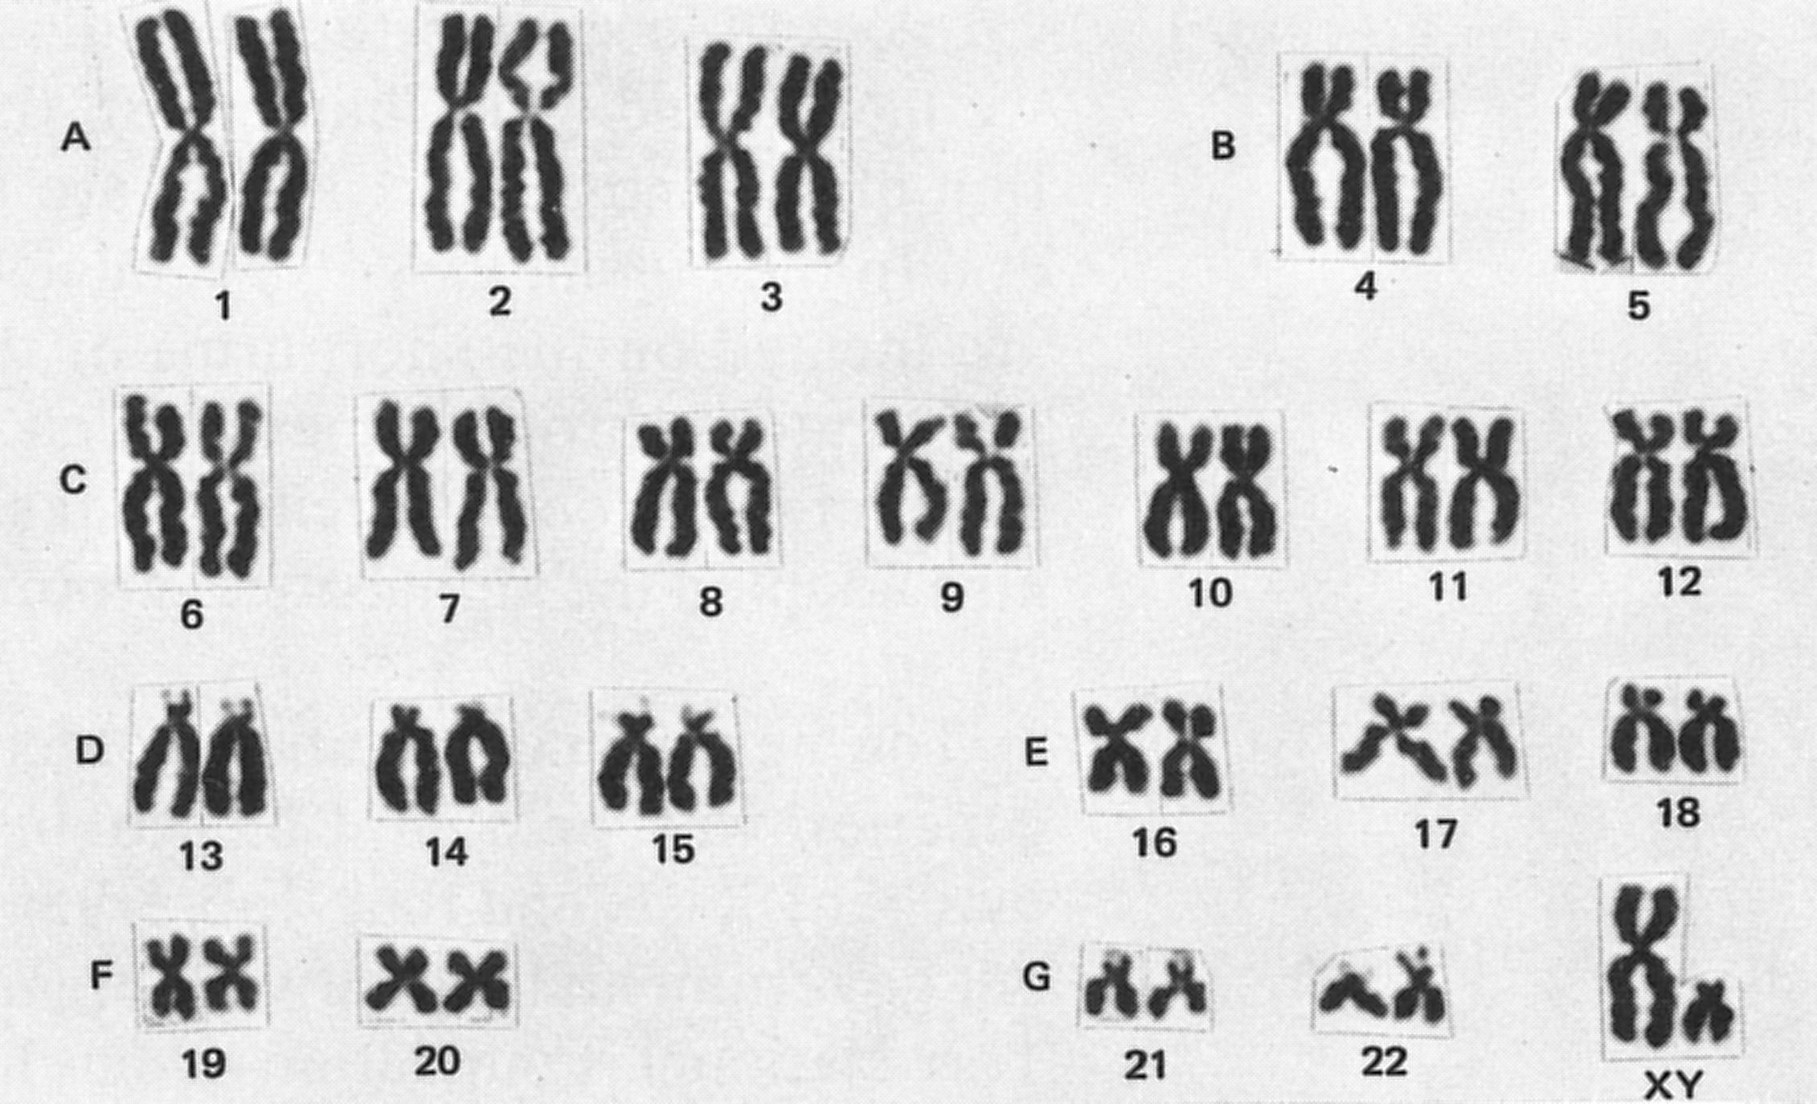
Karyotype
The complete set of chromosomes of an organism.
Note that chromosomes are arranged into pairs.
Each pair are ‘homologous chromosomes’ because they are the same size and shape and code for the same genes. However they may have different alleles.

Slide 8
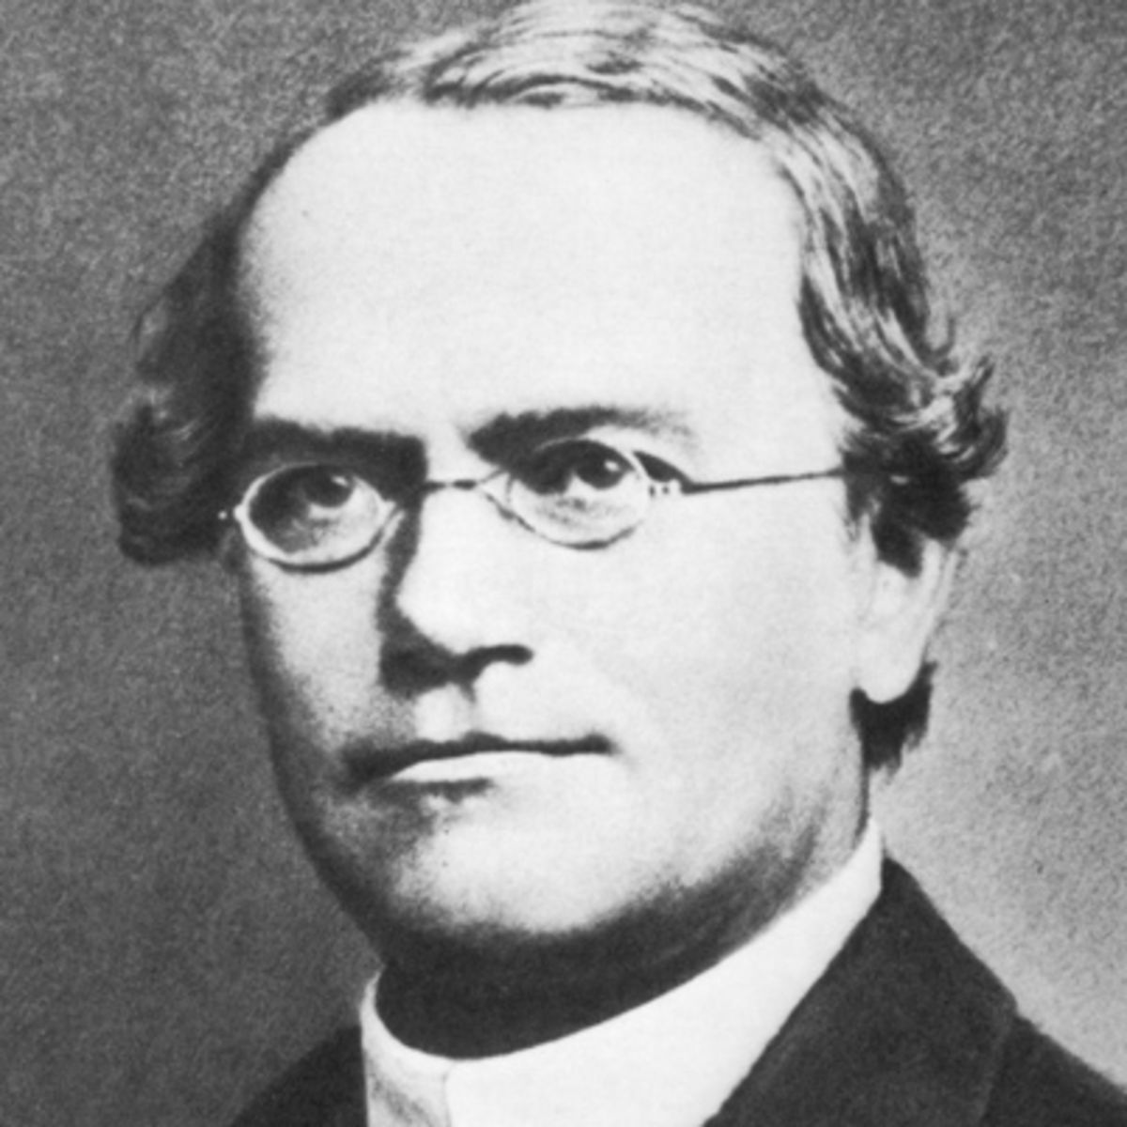
Inheritance
Who is this?

Slide 9
Inheritance
Gregor Mendel – Austrian monk who developed the Patterns of Inheritance Theory using pea plants
Inheritance involves reshuffling of genes from generation to generation

Slide 10
Inheritance
Mendel used a technique involving pure-breeding pea plants that displayed particular traits (tall or short, round pods or wrinkled pods, green pods or yellow pods)
Then cross-bred tall and short plants and grew the resulting seeds.
Found that all offspring were tall…..
Notes:
Why pea plants? They are perfect as they have no intermediate forms (eg medium height or greeny-yellow pods), and they self pollinate meaning they are all pure-bred.

Slide 11
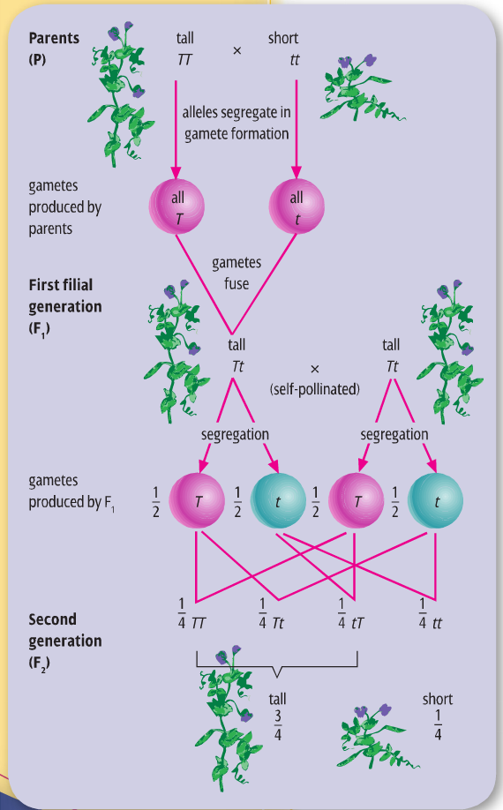
Inheritance
Mendel had used Monohybrid crosses and discovered dominant and recessive traits.
Parent (P) generation all consisted of homozygous alleles
F1 generation resulted in all heterozygous alleles
F2 generation then had the opportunity to be any assortment of alleles

Slide 12
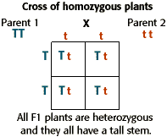
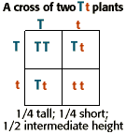
Predicting outcomes of crosses
Using Punnett squares to use an understanding of gamete formation after meiosis and then the possible results of fertilisation.

Slide 13
What do we get from this?
From these test crosses we can predict an individual’s genotype and phenotype
A genotype is the genetic information
A phenotype is the expression of that genetic information.
EG an individual can be short (pheno) and tt (geno) or tall (pheno) and TT or Tt (geno)

Slide 14
Dihybrid cross
A large variety of combinations of traits in possible offspring due to independent assortment
Independent assortment: each of the alleles of one gene may combine independently with each of the alleles of anther gene in a gamete.
See next slide for example

Slide 15
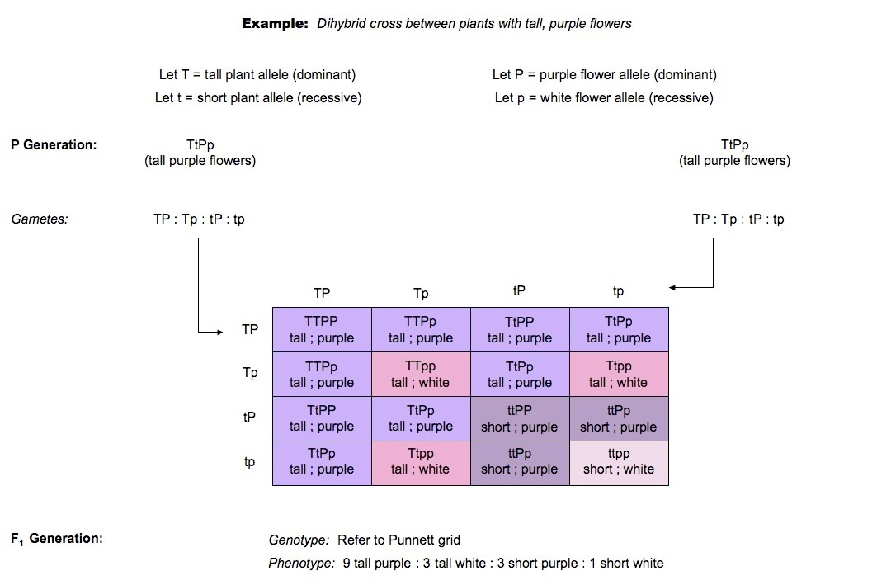

Slide 16
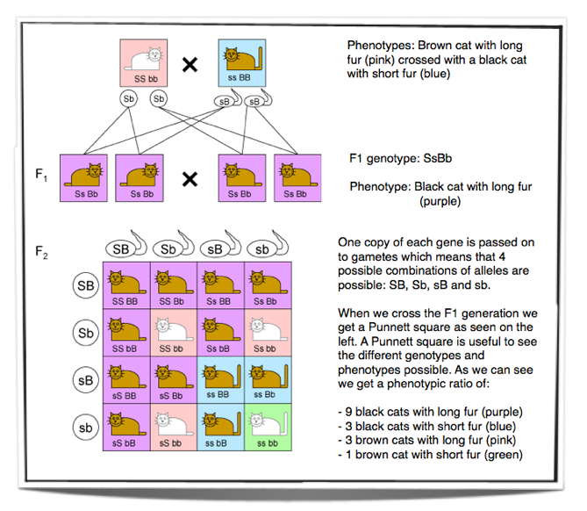
Dihybrid inheritance

Slide 17
Complete, Incomplete/Partial, Co-dominance
Not all genes that are coded for are presented as Mendel had discovered them. He investigated complete dominance where one allele is dominant over another
Inheritance however, is not as straight forward

Slide 18
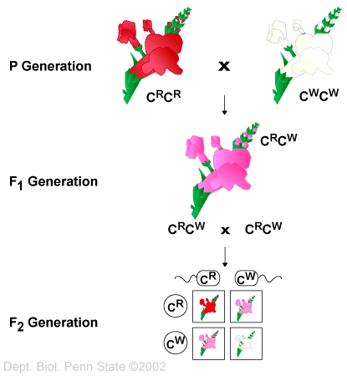
Incomplete or Partial Dominance
On trait is not completely dominant over the other
EG Red Snapdragons (C^{R}) and white Snapdragons (C^{W}) breed together can create pink (C^{R}C^{W})

Slide 19
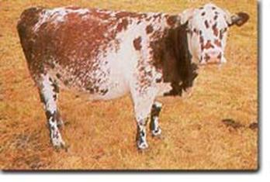
Codominance
Both traits are dominant, therefor characteristics of both traits are displayed in phenotype.
EG White cattle (C^{W}C^{W}) and Red cattle (C^{R}C^{R}) can result in Roan offspring (C^{W}C^{R}).

Slide 20
Incomplete dominance
A cross between a blue blahblah bird & a white blahblah bird produces offspring that are silver. The color of blahblah birds is determined by just two alleles.
What are the genotypes of the parent blahblah birds in the original cross?
What is/are the genotype(s) of the silver offspring?
What would be the phenotypic ratios of offspring produced by two silver blahblah birds?
The color of fruit for plant "X" is determined by two alleles. When two plants with orange fruits are crossed the following phenotypic ratios are present in the offspring: 25% red fruit, 50% orange fruit, 25% yellow fruit. What are the genotypes of the parent orange-fruited plants?

Slide 21
Multiple Alleles
More than two types for a gene.
Eg Blood types humans can have the alleles I^{A}, I^{B} or I
I^{A}, I^{B} are Codominant genes code for particular antigens on the surface of red blood cells.
i is recessive to both other types. It does not code for an antigen. This can also be called O blood group.
Find the possible blood types of offspring with parents:
AB x AA
AB x ii
AA x BO

Slide 22
Blood types Practice questions
A man with Type O blood marries a woman with heterozygous Type A blood. What are the possible phenotypes of the children
A wealthy couple is killed when their yacht is sunk by a hurricane. They leave an estate of 5 million dollars. Six months after their death a man claims he is their long lost son. The man claiming to be their son has blood type A. The wealthy man is type A and his wife is type O. You are the judge. What do you do with the $5,000,000

Slide 23
Lethal Alleles

Slide 24
Mr Lewis has a genetic mutation, none of his direct family have this trait however. Neither do his grandparents on either side of his family. His father’s sister does though, as do both of her children one male one female. Where does it come from?

Slide 25
Pedigrees
Allow us to trace back patterns of inheritance for particular traits.
Individuals in a pedigree can be analysed as Autosomal or Sex-(X)-Linked Inheritance

Slide 26
Pedigree Symbols and meaning

Slide 27
Autosomal Recessive and Autosomal Dominant
Some traits need to be present in an individual as homozygous recessive for them to appear in their phenotype – autosomal recessive
Heterozygous individuals are called carriers
Traits that are autosomal dominant are expressed when minimum of 1 allele is present in genotype

Slide 28
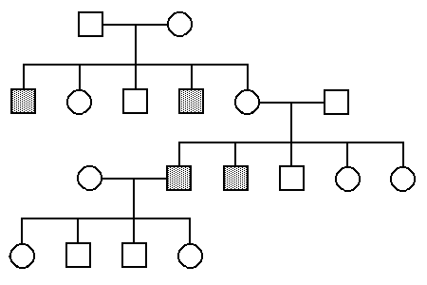
Shaded indicates that the individual expresses the disease ‘Sickle Celled Anaemia’
Is the disease dominant or recessive? How can you tell?
Will any individuals be carriers? What does this mean?
Find the genotypes of all individuals in the pedigree
Find the chance of any children inheriting the disease if a male in the f3 generation married and had children with a female who was a sufferer of sickle cell anaemia.

Slide 29
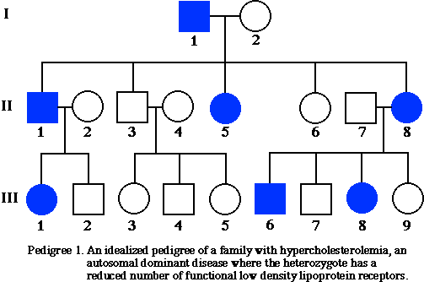
Given that this is an autosomal dominant disease, find the genotypes of all individuals.

Slide 30
X-linked Dominant or Recessive
When alleles for traits are found on the X-chromosome they are sex-linked or x-linked
Females can be heterozygous carriers of x-linked recessive traits or homozygous for the trait
Males can only have or not have recessive traits – only 1 X-chromosome
X-linked dominant traits – same as autosomal for females and same as above for males
Sons cannot receive x-linked traits from father – need to receive Y-chromosome from father.

Slide 31
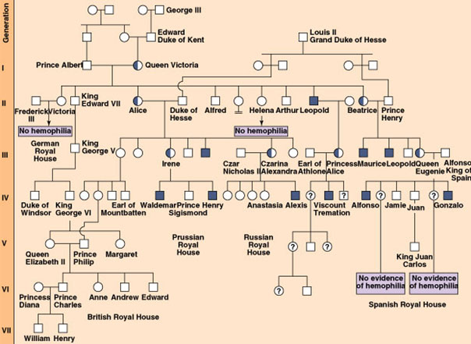
British Monarchy Pedigree for Haemophilia
Is this dominant or recessive?
How do you know?
Who is affected the most by this disease?
Why aren’t there any male carriers of this disease?

