Slide 1
Disruption of cell cycle regulation

Slide 2
Apoptosis
The process from which cells die ☹
Far from being detrimental, apoptosis is an essential process for the growth and development of complex organisms
EG: Tadpole’s tails, webbing in the fingers and toes of developing fetus.

Slide 3
Apoptosis
Genetically programmed into cells
Stages of Apoptosis:
Cell receives signal to die
Cell decreases in volume and membrane begins to bulge
Enzymes break down DNA and nucleus is dismantled
Membrane begins to form blebs
Blebs are engulfed and destroyed by macrophages/ phagocytes

Slide 4
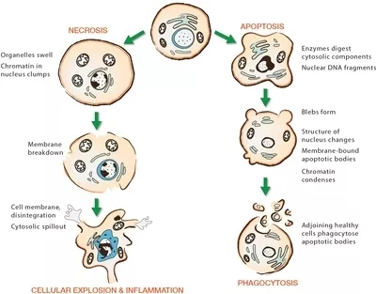
Apoptosis vs Necrosis

Slide 5
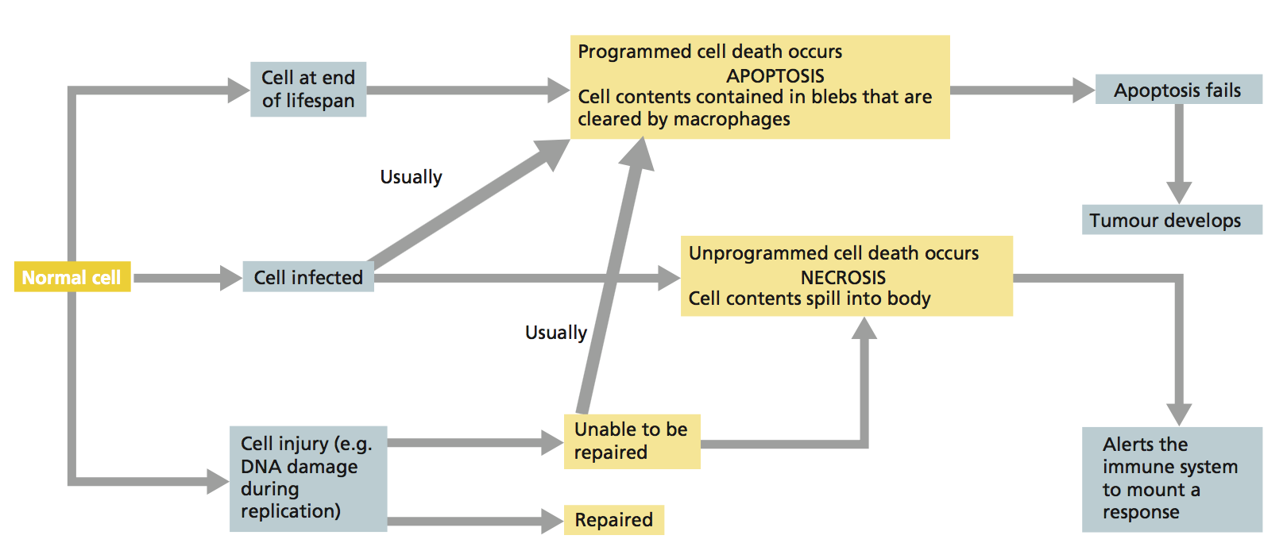
What leads to Apoptosis?

Slide 6
Consequences of Apoptosis failure
Developmental disorders:
Alzheimer’s
Parkinson’s
Huntington’s
Proliferation of damaged DNA can lead to cancers and tumors
Inability to destroy cells infected by viruses.

Slide 7
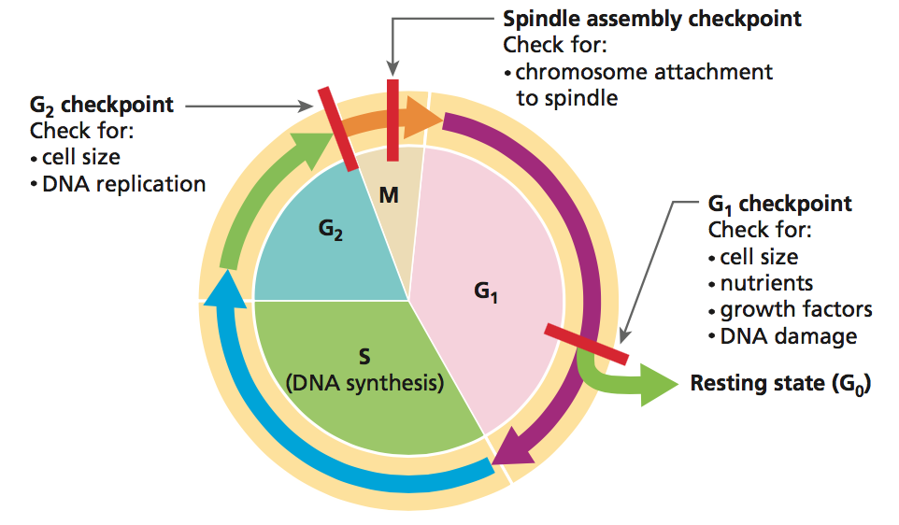
Cell Cycle Checkpoints
Programmed cell death is part of the regulation of the cell cycle
Triggered when cellular processes check DNA and find errors (mutations).
The groups responsible for these checks are cyclins and CDKs (Cycline-Dependent Kinases)

Slide 8
Cell Cycle Checkpoints
G₁ checks for:
any DNA damage
sufficient nutrients
cell size and growth is normal
If any conditions are not met, CDK pauses cell cycle to allow repair.
G₂ checks for:
any DNA damage or replication errors after S phase
Between metaphase/anaphase:
Spindle fibre formation
Attachment to chromosomes

Slide 9
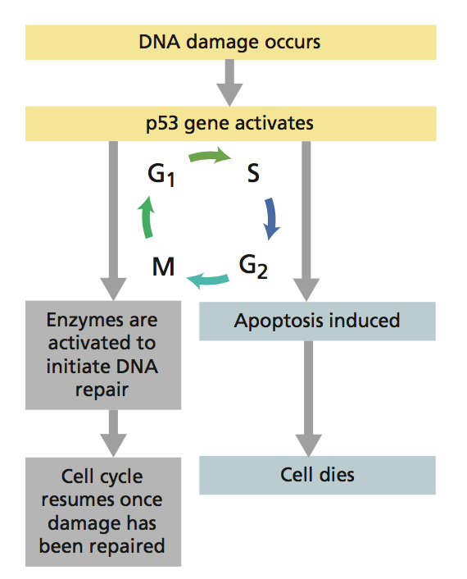
Genetic control of cell cycle
What if there is damage to DNA?
The p53 gene activates
decides whether the DNA can be repaired or the cell is destroyed – Apoptosis.

Slide 10
Genetic control of cell cycle
Two types of genes regulate genetic control within the cell:
Pro-oncogenes (meaning genes that promote cancer)
Tumor-suppressor genes (inhibit cell division)

Slide 11
Mutagens
Agents that increase the frequency or induce mutations in DNA
When mutated, pro-oncogenes can become oncogenes (stimulate excessive cell division, becoming cancerous)
Not the only type of mutation that can occur
Mutations can be triggered by different agents

Slide 12
A large number of agents can be mutagens that permanently alter DNA
People are mainly concerned about mutagens for two reasons:
Most are carcinogens that cause cancer
Germ-line mutations can effect future generations
Mutagens usually classified as chemical, physical, or biological

Slide 13
Types of Mutagens
Chemical agents
Eg. Nicotine, smoke, pesticides, methane, pollutions
Physical agents
UV rays, radiation, extreme heat
Biological agents
Bacteria, viruses

Slide 14
What do all these words have in common?
Notes:
All these have links back to stem cells.

Slide 15
What is a Stem Cell?
the body is made up of about 200 different kinds of specialised cells such as muscle cells, nerve cells, fat cells and skin cells
all cells in the body come from stem cells
a stem cell is a cell that is not yet specialised
the process of specialisation is called differentiation
once the differentiation pathway of a stem cell has been decided, it can no longer become another type of cell on its own

Slide 16
Why are Stem Cells so special?
Stem cells can:
self-renew to make more stem cells
differentiate into a specialised cell type

Slide 17
Types of stem cells
Embryonic stem cells:
Cells from a 5-day old embryo that have the potential to become any cell in the body
Adult (somatic) stem cells:
Undifferentiated cells found in differentiated tissues
Only give rise to new cells from the tissues in which they are found
Eg Cells found in the bone marrow that renew blood cells
Eg Cells found in the dermis that renew skin cells

Slide 18
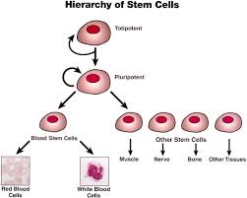

Slide 19
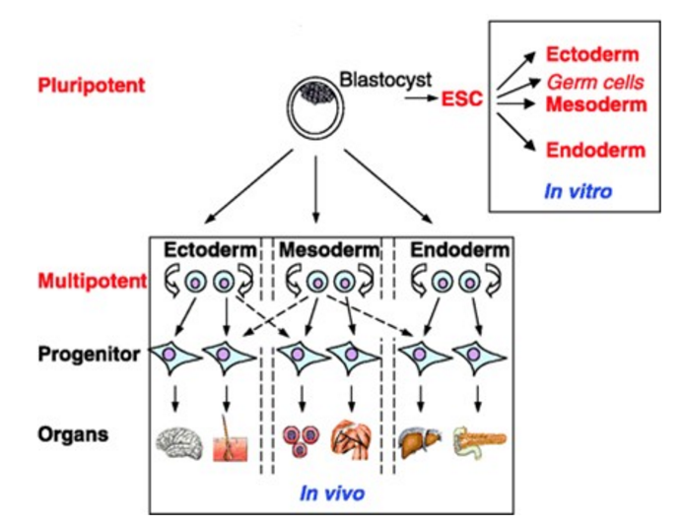
Toti, Pluri, and Multipotency
Pluripotency
Stem cells able to give rise to all cell types that make up the body, but not “extra embryonic” tissue. Eg amnion, chorion, etc.
Embryonic stem cells
Pluripotency can be demonstrated by:
Ability of the daughter cells from a single cell to form derivatives of all three embryonic germ layers (Endo-, Ecto- and Mesoderm)

Slide 20
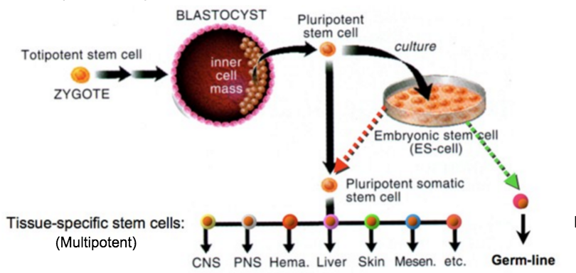
Toti, Pluri and Multipotency
Totipotent
Stem cell able to give rise to all cell types that make up the body, plus all of the cell types that make up extra embryonic tissues. Eg Placenta
Zygote
Multipotent
Stem cell able to develop into more that one type of cell in the body
Adult (Somatic) stem cells

Slide 21
Stem cells and Therapy
Have the potential to be used in therapy to treat various degenerative diseases
Eg Parkinson’s, diabete’s and spinal injuries

Slide 22
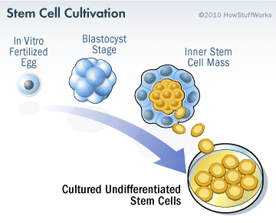
Sources of Stem Cells
3 main sources:
Umbilical Cord and placental blood
Embryonic cells

Slide 23
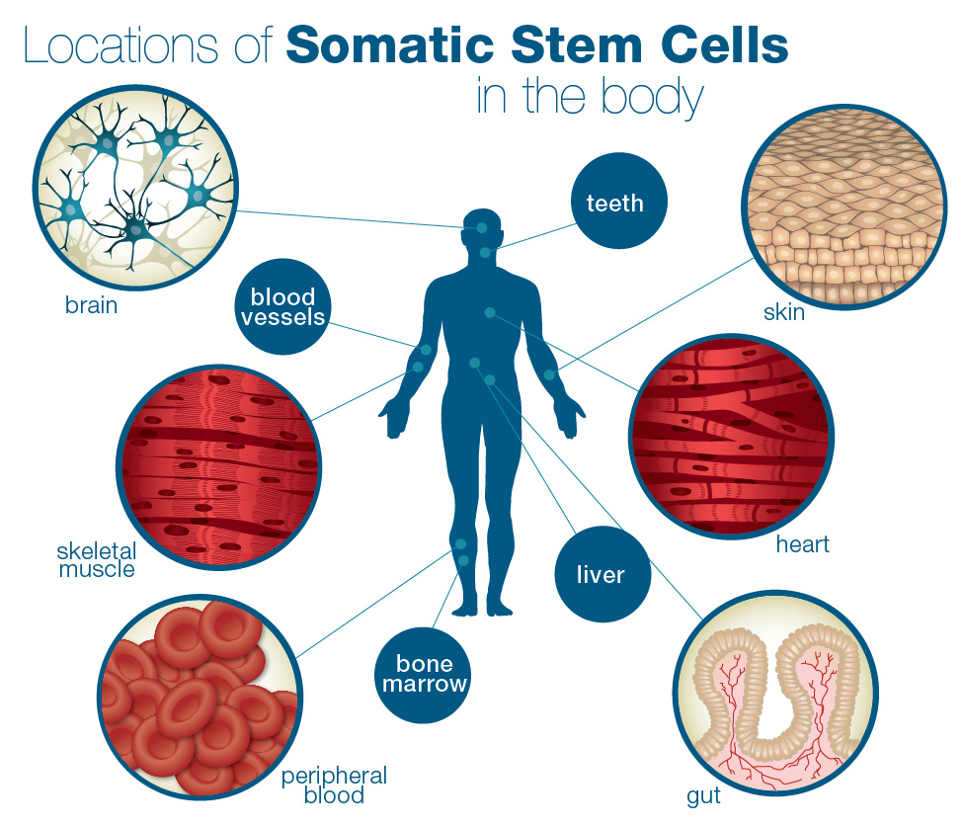
Adult stem cells

Slide 24
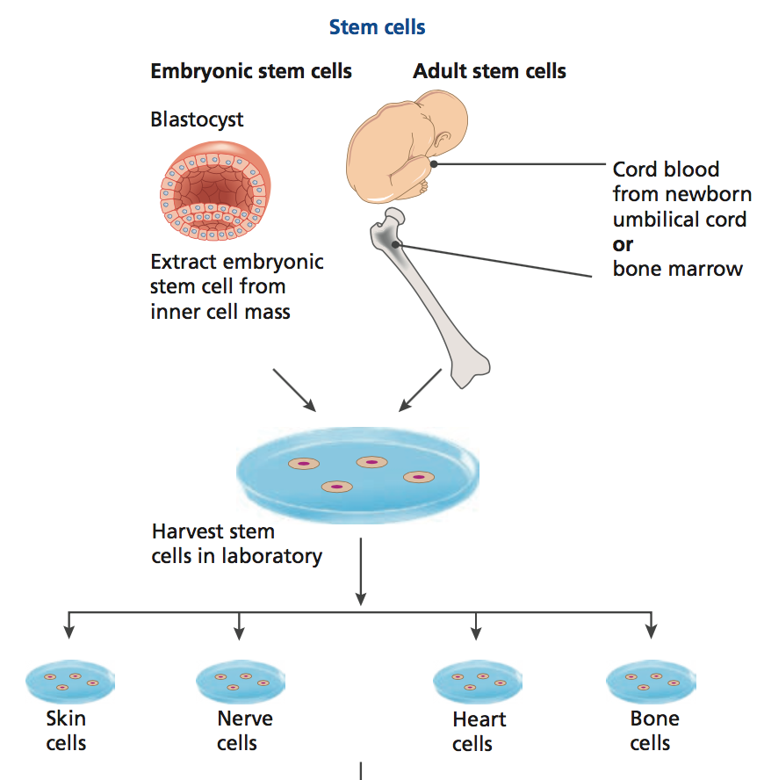
Stem Cell Research

Slide 25
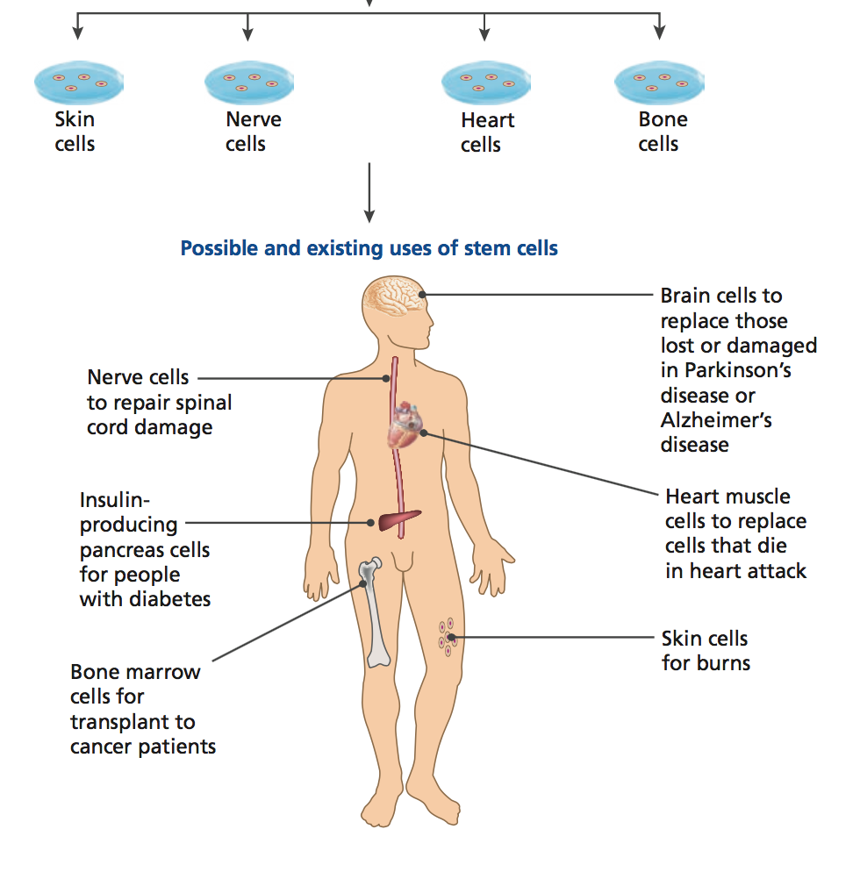

Slide 26
Recap Questions
7.3 → 7.8
Complete the Mitosis and Cell Cycle checkpoints concept map

