Slide 1
Chapter 8: Molecular Genetics
DNA: the universal molecule of life

Slide 2
Key knowledge (from study design)
Molecular genetics
The nature of genomes, genes and the genetic code
Gene expression
The genetic code and roles of RNA in transcription, RNA processing in eukaryotes, and translation.
Gene regulation
Causes of phenotypic variation: mutations

Slide 3
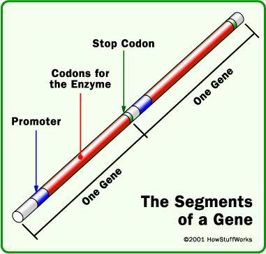
gene
Each gene has a promotor to start transcription and a ‘stop codon’ to stop transcription
Note that the codons in between are not all useful and used to make a protein…

Slide 4
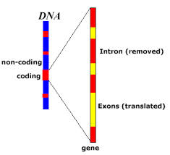
Introns and exons
A gene is actually made of codon sections called ‘exons’ and other codon sections called ‘introns’
Introns are interruptions in the gene. They don’t actually code for the protein.
The actual coding regions of the gene are called exons.

Slide 5
DNA codes for proteins
Everything a cell does is determined by its enzymes and other proteins
They control what it develops into, what it synthesizes, how it operates
DNA’s role is to determine what proteins the cell will make.
Combinations of DNA’s 4 nucleotide bases, code for the amino acids that will be used to produce the protein.
A minimum combination of 3 of these bases, known as a codon, is needed to code for one amino acid….why???

Slide 6
Transcription and Translation
In order to make the protein, information from the DNA must leave the nucleus to find a ribosome. This is the site where the protein is made
DNA does not actually leave the nucleus
A form of RNA goes in its place (mRNA or messenger RNA)
The information from mRNA then gets translated by the ribosome so that it knows which proteins to make

Slide 7
Difference between DNA and RNA
Feature | DNA | RNA
Sugar in nucleotide sub-unit | Deoxyribose | ribose
bases in nucleotide sub-unit | A, G, C, T | A, G, C, and U
Usual structure | double-stranded chain forming a double helix | Single-stranded chain

Slide 8
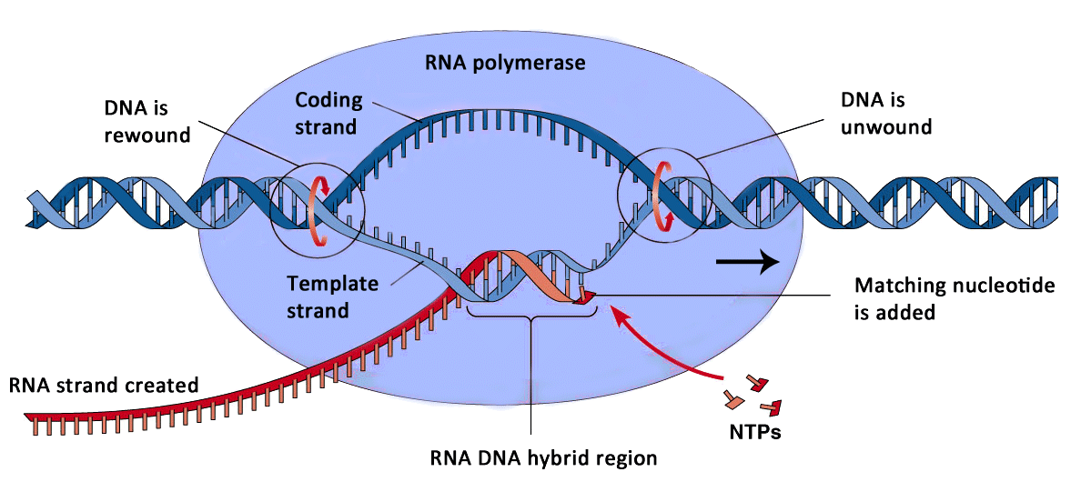
Overview of transcription
A small section of DNA molecule unwinds (the gene) and free-floating nucleotides bind to the strand (via RNA polymerase), creating the mRNA (single strand).

Slide 9
Transcription
RNA polymerase attaches to a specific promotor sequence of DNA on the template strand.
The double stranded DNA of the gene unwinds and exposes the bases of the template strand.
The base sequence of the DNA template guides the building of a complementary copy of the mRNA sequence. The RNA polymerase enzyme moves along the DNA template in a 3’ to 5’ direction and as it moves complementary nucleotides are brought into place and one by one are joined to form an RNA chain.
After the RNA polymerase moves past the coding region and into the down stream region of the gene, transcription stops and the mRNA molecule is released from the template.
This is pre- mRNA

Slide 10
Modification of pre-mRNA
Post-transcription modification:
Capping: 5’ end is capped with an altered G base (methyl guanosine).
Tail: the pre-mRNA is clipped at the 3’ end and a poly-adenine (A) tail with up to 250 A’s is added.
Makes mRNA more stable
Splicing: Regions in pre-mRNA that correspond to introns are cut out, and the remaining exons are spliced together. (Spliceosome enzymes do this work. They recognise GU-…intron…AG)

Slide 11
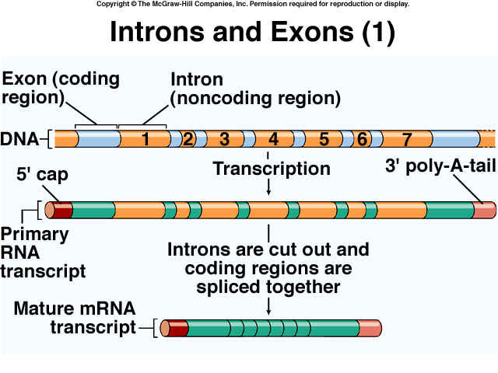

Slide 12
This final mRNA is ready to leave the nucleus. It moves across the nuclear membrane into the cytosol

Slide 13
Quick questions
Where does transcription occur?
What is the end product of this process?
A template strand of DNA includes the base sequence: TATCGGCAT. Write the base sequence of the complementary non template strand.
A strand of mRNA includes the base sequence: AUGUAUCCG. Write the base sequence of the DNA coding strand.
Write two ways in which RNA differs from DNA
List two differences between pre-mRNA and mRNA

Slide 14
Translation
Instructions carried on mRNA are translated into a amino acids that are linked together as a protein chain.
Note that amino acids are present in solution in the cytosol.
Step 1

Slide 15
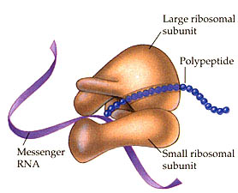
Ribosome
Is composed of a large subunit (60 S) and a small subunit (40S)

Slide 16
Translation
mRNA moves into the cytoplasm and attaches itself to a ribosome.
The ribosome scans the mRNA for an AUG start codon.
Transfer RNA (tRNA) is a carrier molecule. It brings each amino acid to the ribosome.
One end has an ‘anti-codon’ that matches the mRNA condon
The other end attaches to a specific amino acid

Slide 17
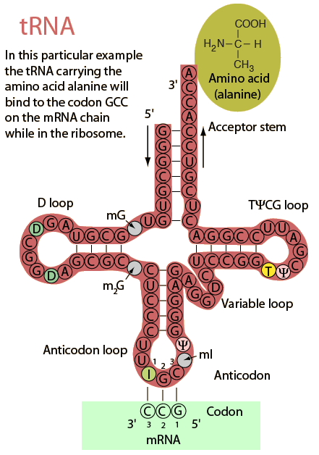
Once tRNA have dropped off their amino acids, that return to the cytoplasm and can be used to pick up another amino acid

Slide 18
4. As the ribosome passes along the mRNA strand, it reads the 3 base codon site and bonds with a complementary tRNA molecule. (this means that amino acids are linked in an order corresponding to the sequence of base triplets in the mRNA).
5. As the ribosome moves along the mRNA strand more and more amino acids are added to the growing polypeptide chain and peptide bonds form between the amino acids.
6. Upon reaching a stop codon, the ribosome detaches the mRNA

Slide 19
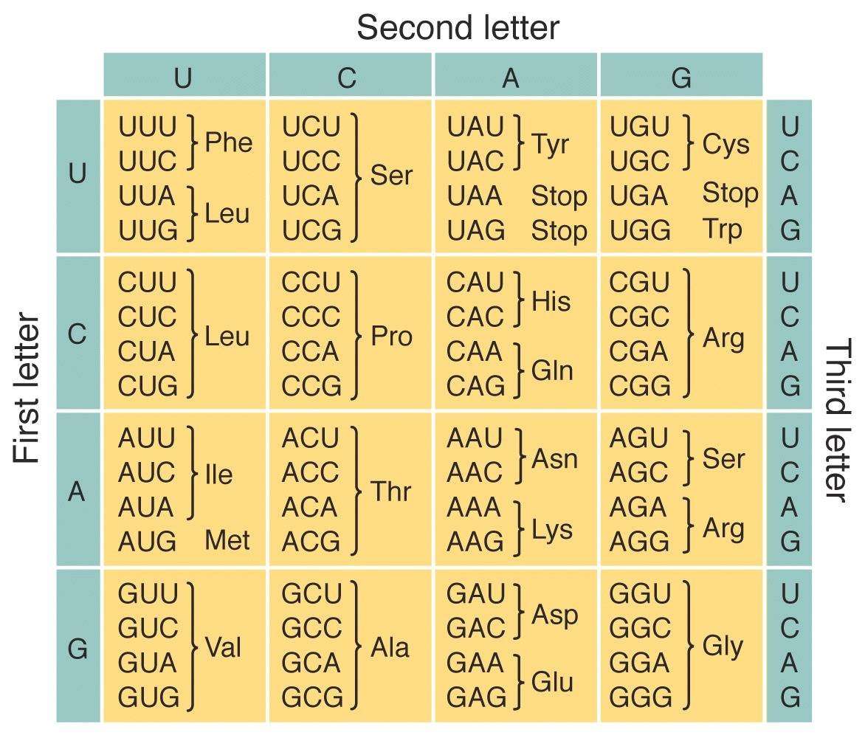
The genetic code

Slide 20
Key players in translation
DNA in nucleus
mRNA
Ribosomes
tRNA
Amino acids
Protein chain
Masterplan with complete instructions of a house
Working copy of one instruction
Construction site
Brickies carrying the raw materials
Raw material (bricks)
Finished house
Create an analogy that links all 6 key players together. See how example above to get the idea

Slide 21
Gene regulation
If one cell contains the entire information to build an entire human being, why does it only become a specific cell in your muscle?
Cells do not express all genes in their genomes at the one time
The speed at which genes are transcribed and translated are controlled.

Slide 22
Gene regulation in prokaryotes
Example E.Coli
Inhabits the gut of mammals. Lives on sugars.
Infant mammals feed on milk. This contains the sugar lactose.
However E.Coli actually prefers glucose, as it is easier to use in cellular respiration. E.coli produces enzymes to break down lactose into glucose.
So
If only lactose is present, E.Coli produces enzymes (turns on the gene to make enzymes) to break down lactose
If lactose AND glucose are present, E.coli turns off the production of enzyme and just uses glucose.

Slide 23
Structural genes – a region of DNA coding for a particular protein
Regulator gene – a gene that codes for the production of a repressor protein that inhibits the action of an operator gene, thereby preventing transcription of a structural gene.
Repressor protein – a protein coded for by the regulator gene that binds to an operator gene, which inhibits transcription of a structural gene.
Operators – a region of DNA situated around a promoter that interacts with a specific repressor; when bound with a repressor protein, it prevents transcription of the structural gene.
Enhancers – regions found in eukaryotic DNA that act as a binding sites for some activator

Slide 24
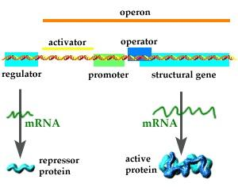
How are the genes controlled in E.coli
The regulator gene, codes for a repressor protein.
If no lactose is available, the repressor protein binds to two sections of non-coding DNA, called operators – see picture
Promoters are a sequence that signals the start of a gene.

Slide 25
How are the genes controlled in E.coli cont…
RNA polymerase binds to the promoter region activating the gene, causing transcription to begin.
When lactose is absent, the repressor protein binds to the operators around the promoter and prevents RNA polymerase attaching to the promoter, blocking the gene

Slide 26
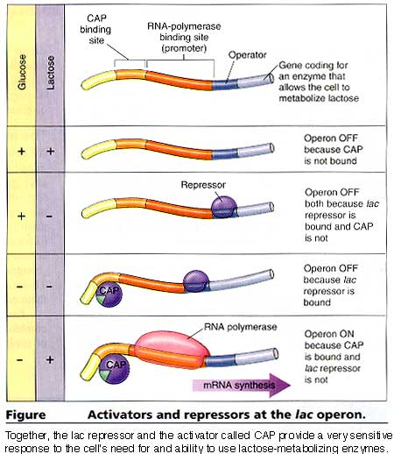
Take note of
when the repressor will bind to the operator
when the RNA polymerase is able to bind to the promoter.

Slide 27
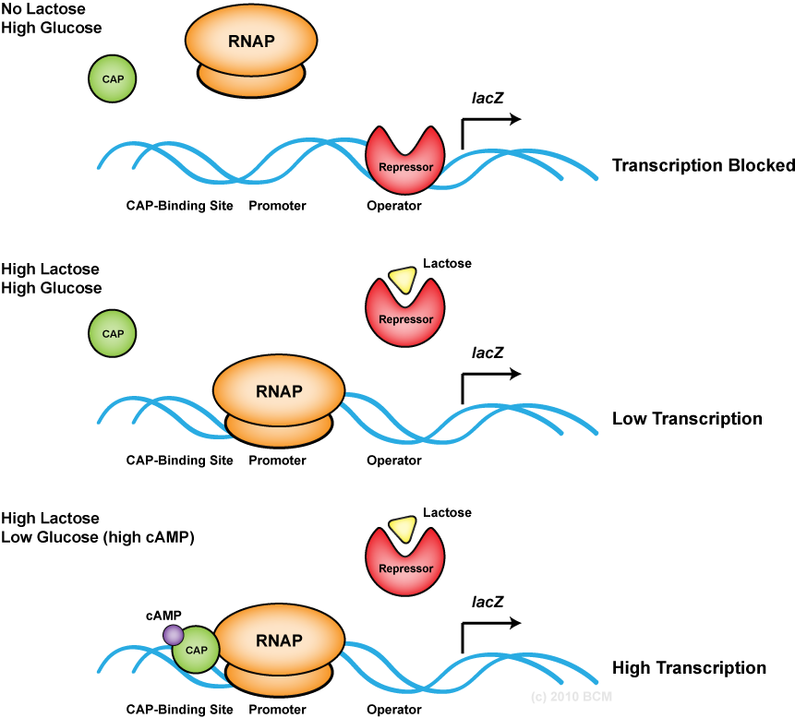
`

Slide 28
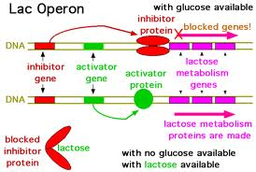

Slide 29
Gene Regulation in Eukaryotes
Of course it is more complicated!
Some things that are known
Enhancers: regions in DNA that act as bindings sites for activator proteins. Increase the number of RNA polymerase molecules transcribing the particular gene.
Chemical modification: if a methyl group attaches to nucleotides, protein synthesis could shut down.

Slide 30
Variation within species
Within a species, there is evidently variation. How do we tell each other apart in this classroom?
Variation could include
Physical or structural features (shape, size, colour)
Or biochemical functioning
Causes
Some due to environmental factors
Most due to genetic

Slide 31
Chromosomes leading to variation
You may look similar to your siblings or share some features, but there is variation within your siblings even though you have the same mother and father supplying the genetic information
More than just dominant/recessive…..
When homologous chromosomes meet up during prophase of meiosis, recombination can occur due to sections of the chromosome ‘crossing over’ or swapping places with the other homologous chromosome.
http://highered.mcgraw-hill.com/sites/9834092339/student_view0/chapter11/meiosis_with_crossing_over.html
Fertilisation of gametes is by chance. Not all mothers gametes are identical
Not all fathers gametes are identical
It is random as to which of the fathers and which of the mothers gametes fuse.

Slide 32
Other chromosomal causes of variation
Multiple alleles for particular traits (eg blood type)
Polygenes – the action of many genes influencing the phenotype

Slide 33
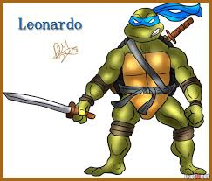
Variation due to MUTATIONS!

Slide 34
Mutations
May be to do with mutations in the genetic code
This means a change to the instructions for building proteins
May be to do with mutations in the number of chromosomes
This means less or more information for creating an organism.

Slide 35
Somatic mutations – occur in the non reproductive cell of the organism
Can not be inherited by offspring
Eg sunbaking caused a mutation in a skin cell. This may result in cancer. This is not passed on to offspring.
Germ-line mutations – occur in a gene or chromosome in a gamete.
Can be inherited by offspring
Eg haemophilia began as a mutation

Slide 36
Gene mutations
Changes to the gene sequence during DNA replication
Note that often these mistakes are fixed by enzymes, but sometimes they are not.

Slide 37
Gene mutations
Substitution
Inversion
Insertion
deletion

Slide 38
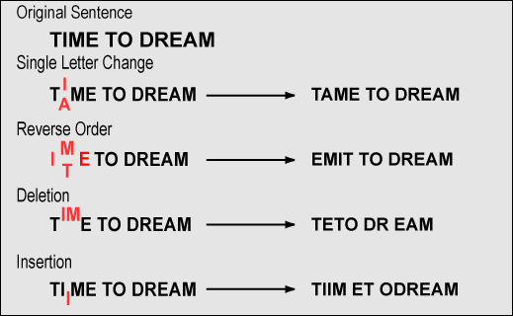

Slide 40
Chromosome
Deletion
Inversions
Translocation
Duplication
Aneuploidy

Slide 41
Chromosome mutations

