Slide 1
Biotechnology

Slide 2
Biotechnology
Using living things and biological systems for human benefits
Using microbes to create food, clear up wastes, produce proteins, produce antibiotics, produce vaccines,
Using DNA manipulation techniques to investigate particular genes etc

Slide 3
Cutting DNA
Restriction Enzymes (also called restriction endonucleases) cut DNA at known specific sequences called recognition sites.
Restriction Enzymes are sourced from bacteria where they naturally occur (to use in an attack of a virus, it will cut the viral RNA/DNA)
The restriction enzyme recognises a specific sequence of double stranded DNA. They bind to this site and cut the double stranded DNA at that point.
The cuts can be:
Sticky ends (overhanging cuts)
Blunt ends (cut has occurred at same position on both strands)

Slide 4
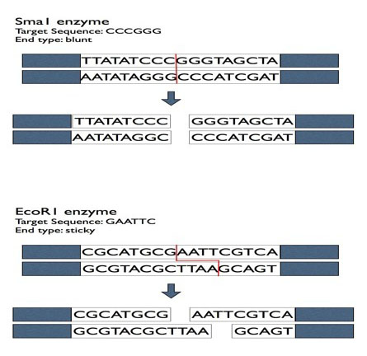

Slide 5
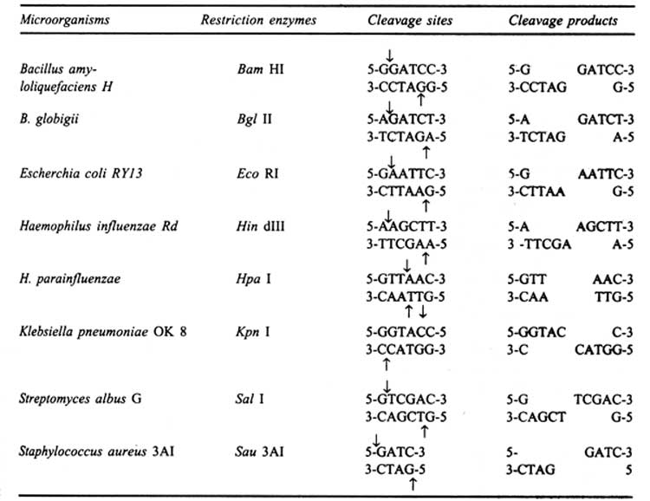

Slide 6
Recombinant DNA
Combining two samples of DNA
DNA ligases are enzymes that join two different pieces of DNA together.
Naturally occur in cells and repair broken DNA
Re-establish hydrogen bonds between nucleotides
In the lab: two DNA fragments have been cut with the same restriction enzyme (same sticky ends)
DNA ligase used to recombine these two fragments (even if from different organisms)

Slide 7
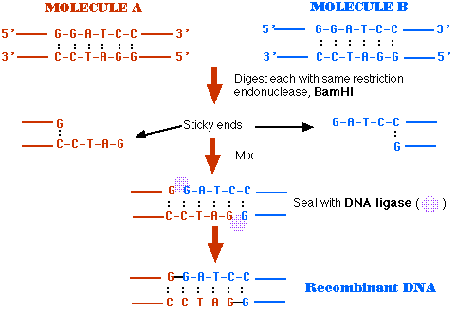

Slide 8
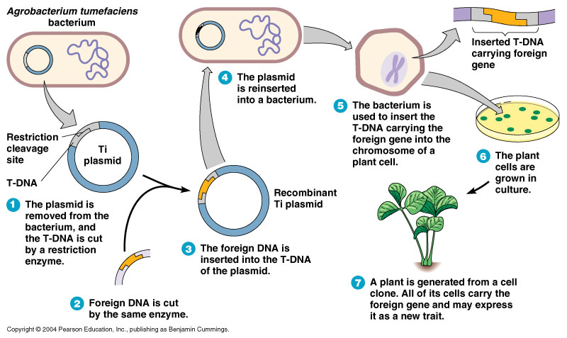
Example of recombinant DNA using bacteria and foreign DNA

Slide 9
Making lots of copies of the DNA sequence
Making lots of copies of DNA is called DNA amplification
It is done through the process called Polymerase Chain Reaction (PCR)
Why does DNA need to be copied multiple times?
Only a small sample of the DNA may have been available
Eg at a crime scene, if it has been extracted from a fossil etc
Having lots of copies of the same pieces of DNA mean that scientists can do better and meaningful analysis of the sequences (in a range of different experiments)
These days a machine will carryout the process but it can be done manually

Slide 10
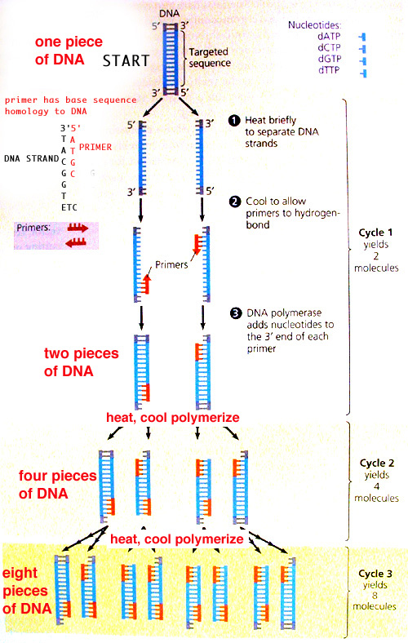
PCR
Three Steps
Denaturation
DNA is heated to 95°C
Breaks the hydrogen bonds
Strands separate
Attach primers
Temperature is reduced to 50°C.
this allows the primers to anneal (join)
Extension
The temperature is raised to 72
DNA polymerase adds nucleotides to the 3’ end of each primer
The PCR machine repeats this cycle at least 30 times.
Each new piece of DNA is then used as a template to make two more

Slide 11
PCR
To complete a PCR you would need
Sample of extracted DNA (no longer part of the cells etc)
DNA polymerase
A buffer solution that contains salts and other chemicals that help the polymerase to function
Nucleotide bases (A, T, G, C)
2 Primer sequences (short sequences of single stranded DNA, complementary to sequences at either end of the section of DNA wanting to be copied.
PCR machine

Slide 12
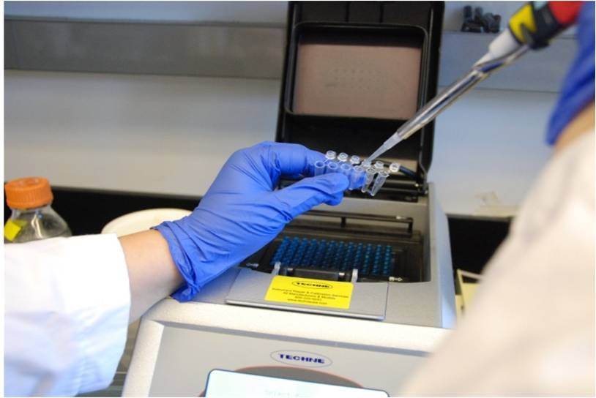

Slide 13
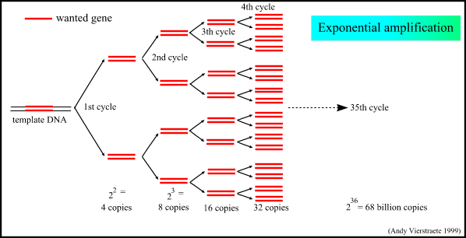

Slide 14
Gel electrophoresis
Separates fragments of DNA according to their size (length).
A restriction enzyme may be used on different samples being tested. It will cut the same sequence, but depending on species this cut may be a different spots on the DNA strand and so create different lengths of DNA fragments.
The DNA sample is then placed at one end of a gel
The gel is exposed to an electric field (one negative end at the start and one positive end)
The DNA then moves through the gel towards the positive end
This is because DNA has an overall negative charge, because of the phosphate groups in their sugar-phosphate backbone. This means they move towards a positive pole.
Short DNA fragments move quickly and further than longer fragments
This causes a band pattern

Slide 15
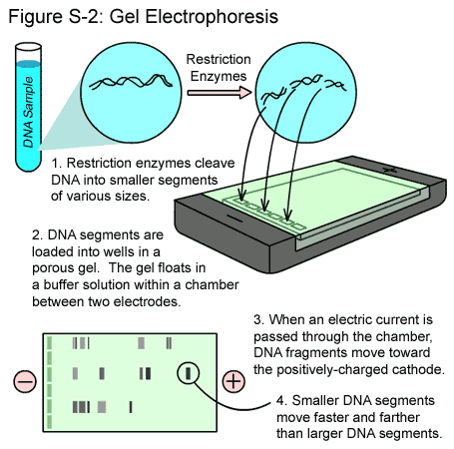
What you need:
DNA sample cut with restriction enzymes
Gel
comb
Electrophoresis machine
Micropippete to transfer small amount into wells
Buffer

Slide 16
To view the gel with DNA fragments
The gel must be mixed with a loading dye that attaches to the DNA before being loaded into the gel.
This dye will fluoresce under UV light
Then the DNA fragment banding can be photographed.
A molecular marker is also loaded into one of the wells. It contains DNA of known sizes that can be used to compare the length of sample fragments

Slide 17
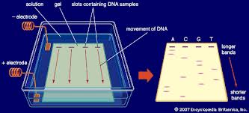

Slide 18
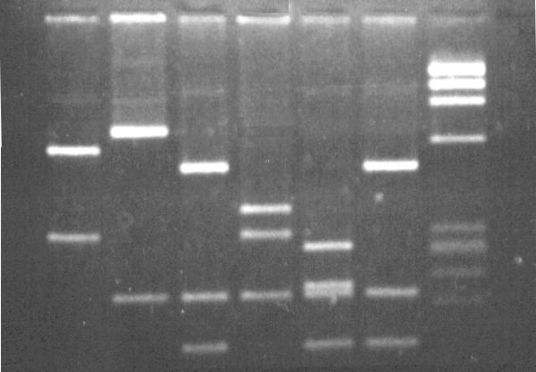
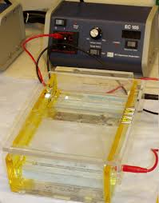
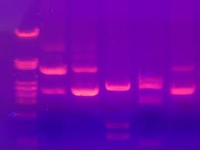

Slide 19
Probing for genes
A gene probe
Is single stranded DNA, usually of length 20 – 40 nucleotides
Complementary to a known sequence of DNA from a specific gene.
Usually has a radioactive tag or fluorescent dye that can be seen when photographed or under UV light
Gene probing
The sample DNA is heated to separate strands
This exposes the sequences and allows the probe to bindto the target sequence in DNA of interest

Slide 20
Gene probing
This technique can be useful when trying to identify whether family member have inherited a particular gene.
Can be used to identify the location of a gene on a chromosome
Identify the allele of a specific gene responsible for a disease

Slide 21
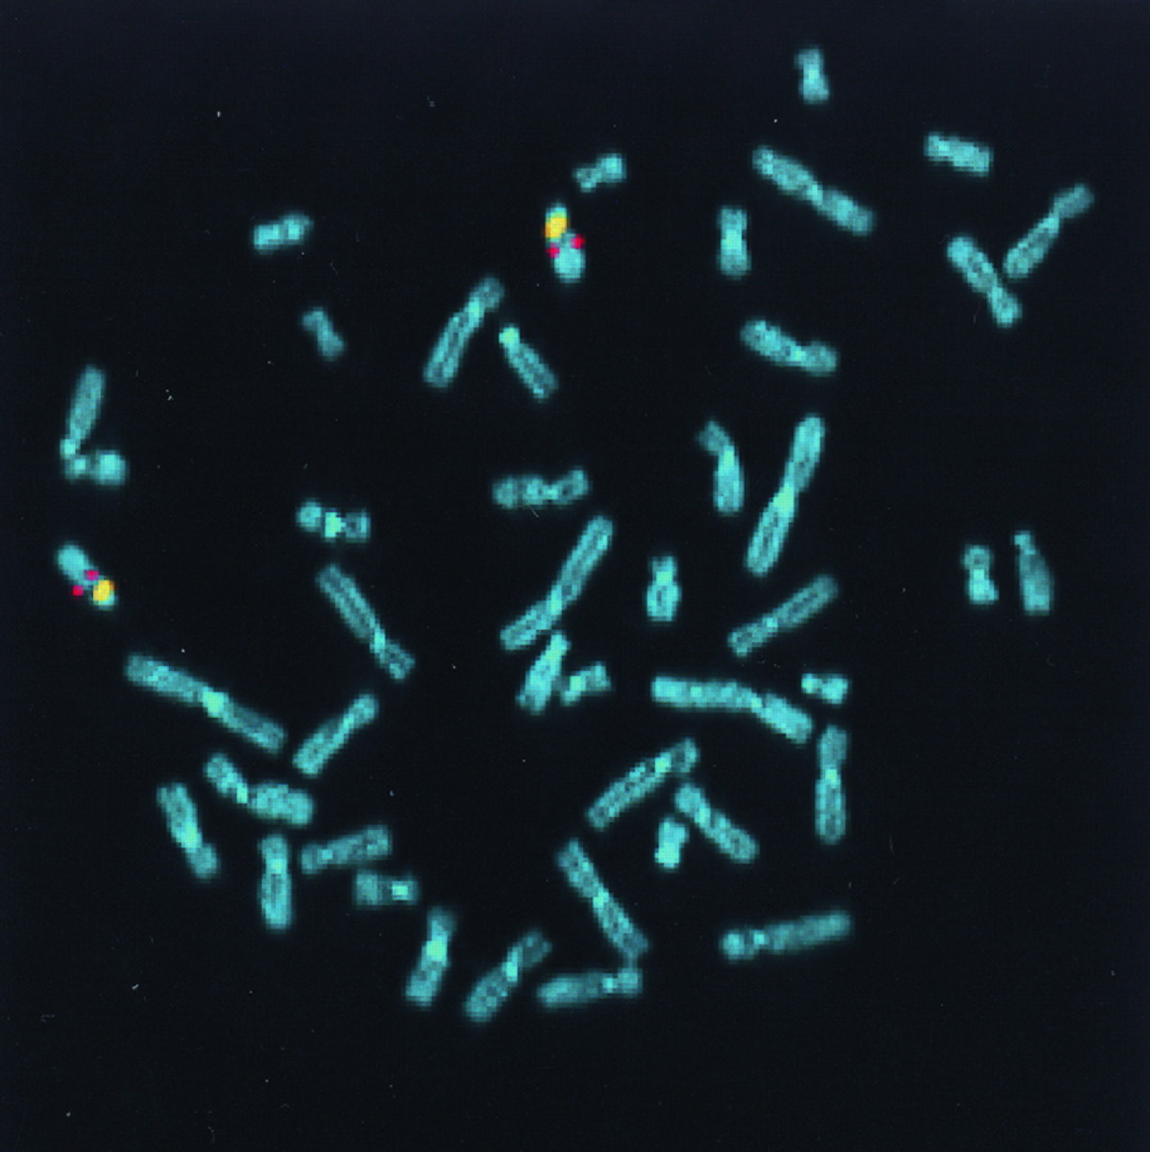
The probe is yellow.
Can you see it?

Slide 22
DNA sequencing
Finding out the exact nucleotide base sequence of the sample of DNA
Can be done using gel electrophoresis or using machines (this is much quicker)
The four nucleotides are labelled with different coloured fluorescent dys.
One lane of a gel is used
A computer analyses the information by using a laser to scan the different dyes and thus gives the base sequence

Slide 23
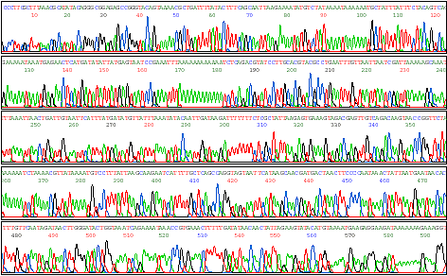

Slide 24
Applications of Biotechnology

Slide 25
Gene cloning
Making copies of a gene while it is in an organism, where it can still function.
Could be used to study how a particular gene functions or to produce a particular protein and harvest it for human use.
Gene/s of interest are inserted into bacterial plasmid
Plasmids are circular pieces of DNA that reproduce independently of the bacterial chromosome

Slide 26
Gene cloning
Plasmids are extracted from bacteria by rupturing the cell walls
Restriction enzyme cuts the plasmid DNA and the DNA of gene to be inserted.
This makes sticky ends on both fragments
DNA ligase binds the foreign gene into the plasmid DNA
Recombinant plasmid is then ‘taken up’ by the bacterial cell by transformation
The bacterial cells then replicate and the new gene becomes part of growth and division

Slide 27
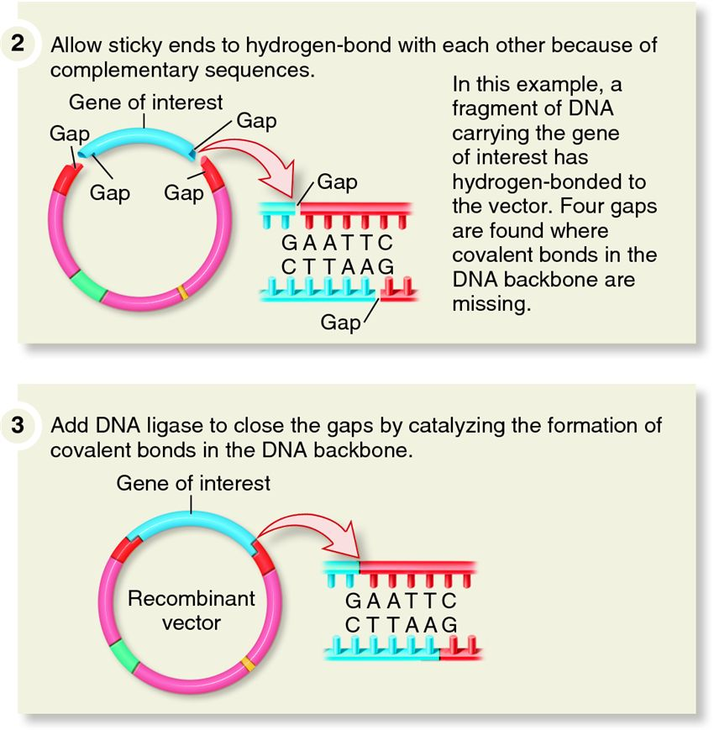

Slide 28
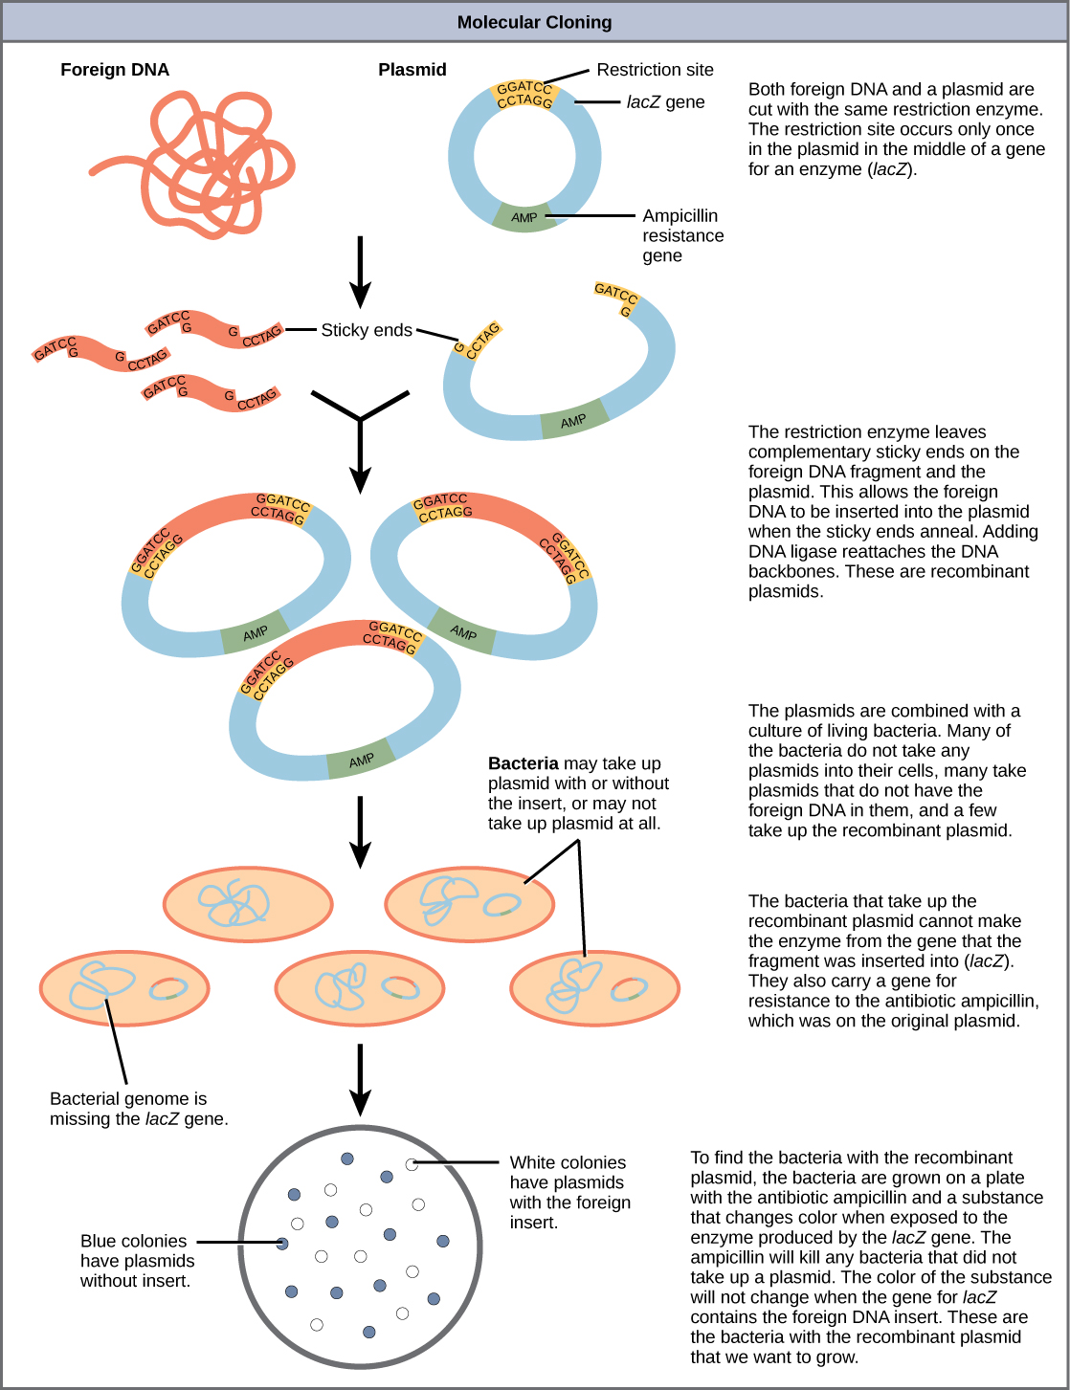

Slide 29
Gene Cloning
Only a small number of bacteria take up the plasmid.
After transformation bacterial cells that have the recombinant plasmid need to be isolated
Plasmid may contain genes resistant to an antibiotic
Cells would be grown in a medium containing the specific antibiotic. Those with out the recombinant gene wouldn’t survive.
Those with the gene are selected and grown in culture.

Slide 30
http://highered.mcgraw-hill.com/olcweb/cgi/pluginpop.cgi?it=swf::535::535::/sites/dl/free/0072437316/120078/micro10.swf::Steps%20in%20Cloning%20a%20Gene

Slide 31
Transferring Genes
Transforming organisms other than bacteria
Used for producing desired protein/product by a particular organism
May be used in ‘gene therapy’ for a person suffering a genetic disease.
Gene is usually inserted into a vector that will carry the gene into the desired organism.
plasmids, viruses, liposomes
If injected directly into cell, DNA may be degraded by cellular enzymes.
Transgenic organisms, also called genetically modified organisms have developed from cells that have had foreign DNA inserted into their genome

Slide 32
Viral Vectors
Viral vectors infect target cells by injecting their nucleic acid into the host cell.
DNA is inserted into viral DNA or RNA using recombinant DNA techniques.
Virus then injects DNA with desired gene into cell.
Viral genes that may cause disease are disabled or removed.
One issue in using viruses as vectors is that the human immune system attacks them

Slide 33
Liposome vectors
Small circular molecules that are surrounded by a single membrane composed of a phospholipid bilayer.
Phospholipid can fuse with other membranes to deliver contents into cell.
Can be made artificially. Can have specific molecules that can be recognised by specific cells.

Slide 34
Plasmid vector
Recombinant plasmids can be inserted into a new organism without using bacteria
Human immune system does not respond as it is not the entire bacteria being inserted
But not efficient as DNA is not stable in body cells.

Slide 35
Cloning
Making an identical copy of an original
Gene cloning using recombinant technology
Whole organism cloning (reproductive cloning)
By embryo splitting
Or nuclear transfer

Slide 36
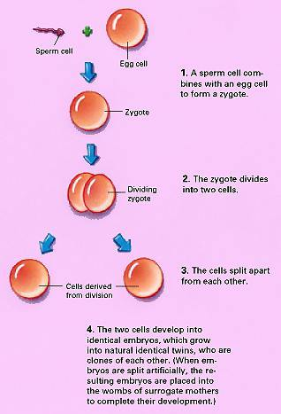
Embryo splitting
Egg cells are removed from a donor female and fertilised in vitro by sperm from the male.
After zygote has divided, scientists remove the coat around the two cells that promotes cell division, and separates the two cells.
Each cell is given artificial covering to promote cell division
The blastocyst is implanted into the surrogate mother

Slide 37
Nuclear transfer
Mature donor somatic cells removed from mature animal
Recipient egg cell is removed from another animal (of same species)
Donor cells are cultured in nutrient medium before becoming inactive. Nucleus of the recipient egg cell is removed
Donor cell is fused with the ‘hollow’ egg by an electrical impulse.
The single celled embryo is cultured for about a week, cell division is activated and the blastocyst is implanted into a surrogate mother.
Offspring will be genetically identical to the donor mother.

