Slide 1
Biology Unit 1: Commencement Week
Welcome to Year 11 Biology 2017

Slide 2
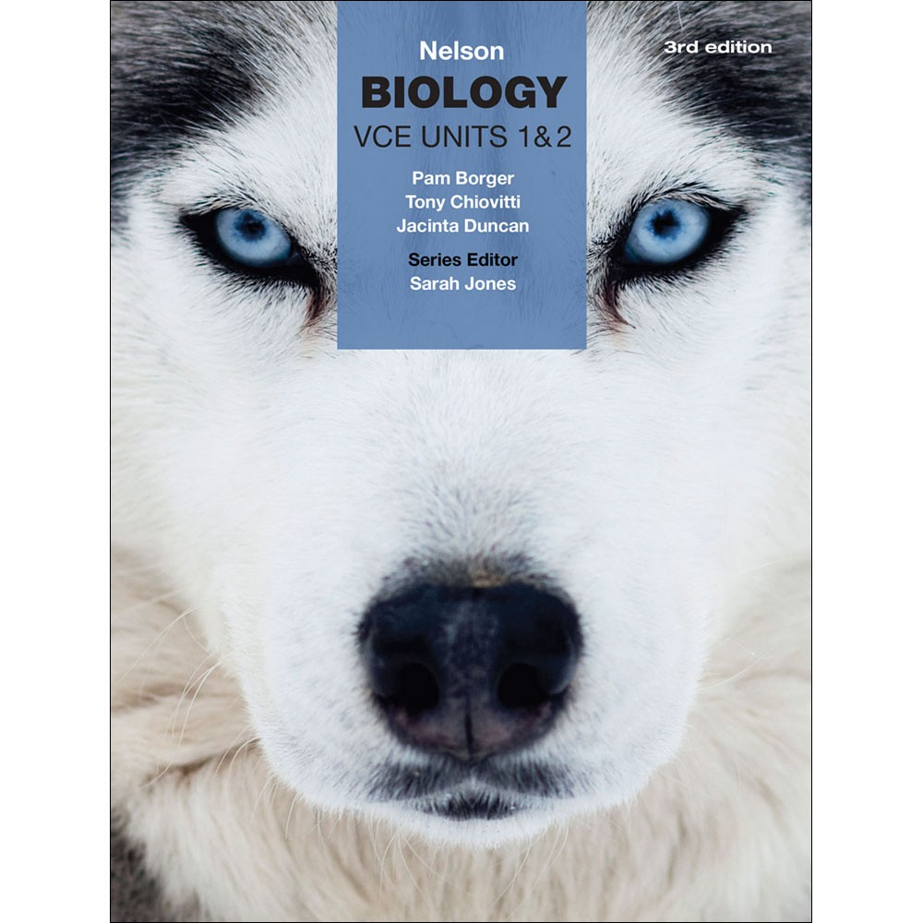
What will you need?
Text book Nelson VCE Biology units 1&2 3rd edition:

Slide 3
What will you need?
Leather shoes
Internet/ device (or the initiative to use the school library/ study rooms)
A binder folder/ folder with pockets
A study schedule
Focus and preparation

Slide 4
What will you be doing?
Refer to the Unit outline for unit 1
Semester 1 (Unit 1) has:
6 practical experiments
2 demonstrations
1 excursion – Wed 15th Feb

Slide 5
What will you be doing?
There are 3 SACs (School Assessed Coursework) for Unit 1
SAC 1 & 2 based on the practical experiments, demonstrations, and excursions for that outcome
SAC 3 Practical Investigation that will be reported (topic TBC)
Need to receive an S for each to pass the Unit.

Slide 6
How will I remember all those experiments, demos and excursions??
You will be given a Logbook that can be used during assessments.
IT WILL NOT BE A WORKBOOK!
If you lose it or abuse it, you could fail the unit as it is required for assessment in 2017.

Slide 7
Is Biology hard?
All science is difficult – BUT…..
If you open your mind to the opportunities
complete the work (especially homework)
ask the right questions
Be prepared for EVERY learning experience
…Biology won’t be so hard!

Slide 8
Will you help me at all?
It all sounds very “doom and gloom” doesn’t it?
Tell you what.. Head to:
http://mrlewis-vcebiology.weebly.com/
Also:
There will be a Facebook page set up for Units 1&2 in 2017

Slide 9
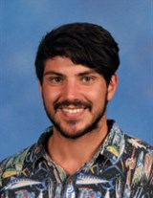
Mr Lewis and Mr Hebbard
Notes:
Both teachers will be here to help you throughout the year – there will be no ‘class vs class’ or favoritism or bias – we are all one big team, including the Year 12 class and we will be contributing equally to how the curriculum works out and how SACs are marked.

Slide 10
Are there any questions?

Slide 11
Kahoot….
Have you ever played kahoot before?
No…?
It’s great!
We do it a bit in Biology.
You’ll need your own device..
https://kahoot.it/#/
Notes:
Play the Kahoot “Commencing with Biology!“
This will get students familiar with Kahoot and what it can be used for. It’s also a great way to get students into the session and loving class.
You’ll need to create an account if you don’t have one. Don’t worry, it’s free! Same for students.
Once you’ve done that, you load up a game and get students to enter the game pin.
“Commencing with Biology!” has a couple prior knowledge questions and some funny ones about Mr Lewis and Biology in general..

