Slide 1
Genetic Crosses and Pedigree Analysis
Chapter 10 part II

Slide 2
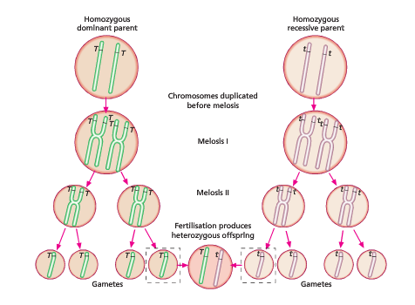
Predicting outcomes of crosses
Using Mendel’s research, modern genetics has ways of predicting the outcomes of fertilisation.
Using Punnett squares to use an understanding of gamete formation after meiosis and then the possible results of fertilisation.

Slide 3
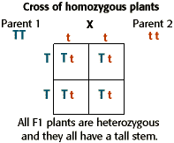
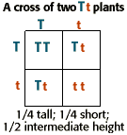
The Monohybrid Cross
Inheritance of a single autosomal gene.

Slide 4
What do we get from this?
From these test crosses we can predict an individual’s genotype and phenotype
A genotype is the genetic information
A phenotype is the expression of that genetic information.
EG an individual can be short (pheno) and tt (geno) or tall (pheno) and TT or Tt (geno)

Slide 5
Dihybrid cross
A large variety of combinations of traits in possible offspring due to independent assortment
Independent assortment: each of the alleles of one gene may combine independently with each of the alleles of anther gene in a gamete.
See next slide for example

Slide 6
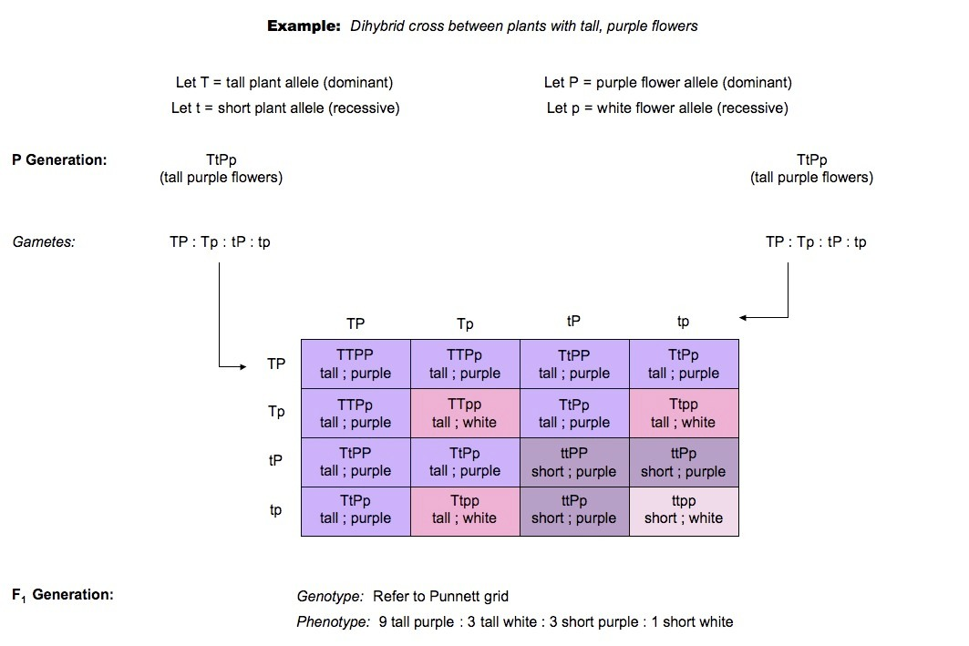

Slide 7
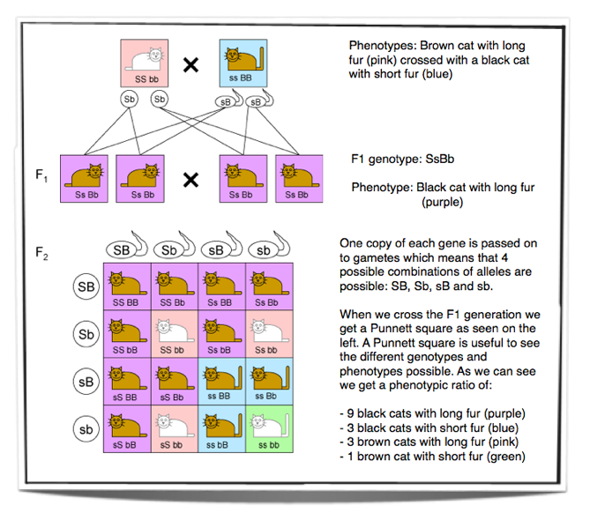
Dihybrid inheritance

Slide 8
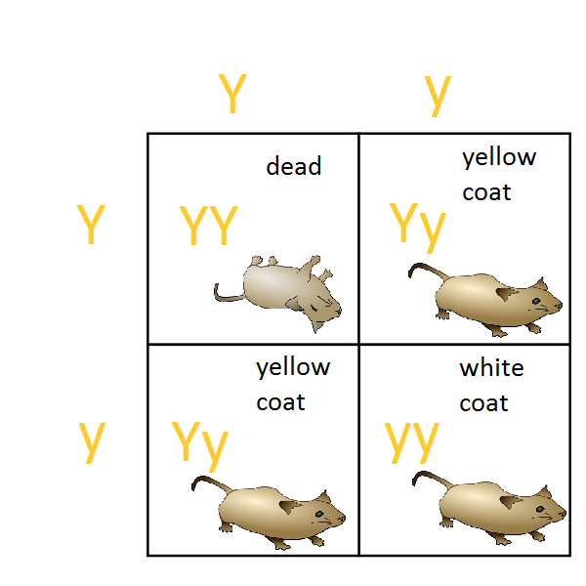
Lethal Alleles
Alleles that cause an organism to die only when present in homozygous conditions are called lethal alleles.
Are often inherited as recessive mutations, recessive lethal alleles that kill only homozygotes
Lethal alleles are often detected as distortions in segregation ratios, where one or more of the classes of expected progeny are missing
EG: coat colour gene in mice
EG: Huntington disease

Slide 9
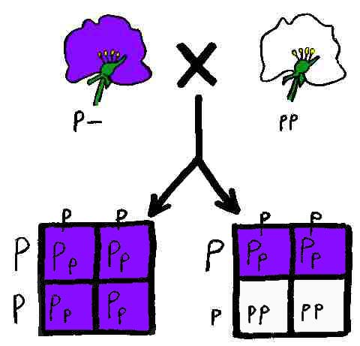
Test Crosses
Used to determine the genotype of an individual that displays a dominant trait
EG PP or Pp
Cross with homozygous recessive (pp)
If offspring are pp, then parent must be Pp.
Offspring are Pp then parent is PP.

Slide 10
Mr Lewis has a genetic mutation, none of his direct family have this trait however. Neither do his grandparents on either side of his family. His father’s sister does though, as do both of her children one male one female. Where does it come from?

Slide 11
Pedigrees
Allow us to trace back patterns of inheritance for particular traits.
Individuals in a pedigree can be analysed as Autosomal or Sex-(X)-Linked Inheritance

Slide 12
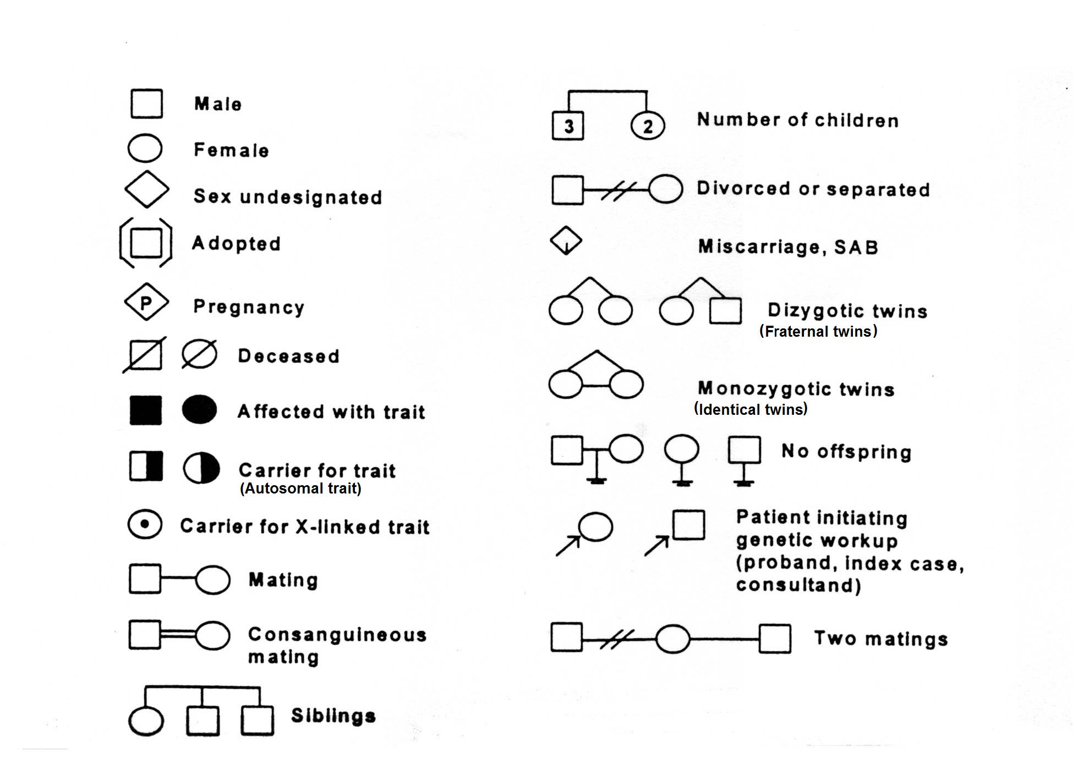
Pedigree Symbols and meaning

Slide 13
Autosomal Recessive and Autosomal Dominant
Some traits need to be present in an individual as homozygous recessive for them to appear in their phenotype – autosomal recessive
Heterozygous individuals are called carriers
Traits that are autosomal dominant are expressed when minimum of 1 allele is present in genotype

Slide 14
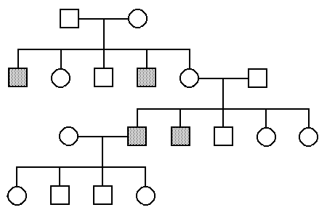
Shaded indicates that the individual expresses the disease ‘Sickle Celled Anaemia’
Is the disease dominant or recessive? How can you tell?
Will any individuals be carriers? What does this mean?
Find the genotypes of all individuals in the pedigree
Find the chance of any children inheriting the disease if a male in the f3 generation married and had children with a female who was a sufferer of sickle cell anaemia.

Slide 15
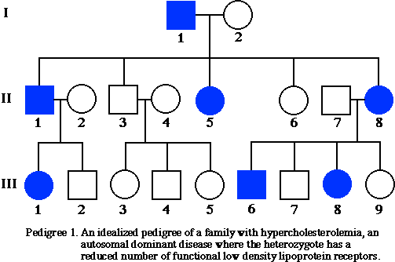
Given that this is an autosomal dominant disease, find the genotypes of all individuals.

Slide 16
X-linked Dominant or Recessive
When alleles for traits are found on the X-chromosome they are sex-linked or x-linked
Females can be heterozygous carriers of x-linked recessive traits or homozygous for the trait
Males can only have or not have recessive traits – only 1 X-chromosome
X-linked dominant traits – same as autosomal for females and same as above for males
Sons cannot receive x-linked traits from father – need to receive Y-chromosome from father.

Slide 17
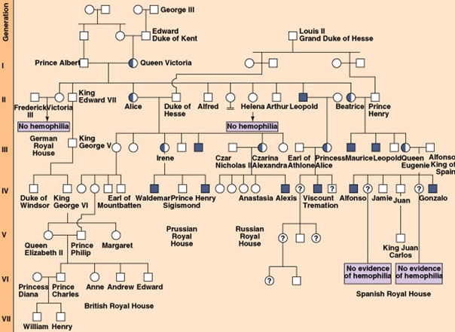
British Monarchy Pedigree for Haemophilia
Is this dominant or recessive?
How do you know?
Who is affected the most by this disease?
Why aren’t there any male carriers of this disease?

