Slide 1
Genotypes, Phenotypes and Mendel’s Inheritance
Chapter 10

Slide 2
Genes: a review
Genes are the basic unit of heredity
Each chromosome contains many genes that code for different traits.
Eye color
Gene
Eye color
Gene
Hair color
Gene
Hair color
Gene

Slide 3
Genes: a review
All sexually reproducing organisms have two of every gene
One from mom and one from dad

Slide 4
Genes
Genes are like committee members; all of the genes (the genotype) sit down together at a table and decide what the organism is going to look like (the phenotype)

Slide 5
Genotype
Genotype- The inherited instructions an organism carries within its genetic code
Each gene has an opinion (an allele).
When all of the genes are together at the table, they state what their opinion is (what allele they are).
Allele:
  An alternate form of a gene
  Think of alleles as different
  flavors of genes

Slide 6
Genotype
A
b
c
a
C
B

Slide 7
Dominant Alleles
Genes have different personalities
Some genes are loud and bossy. They are always convinced that their ideas are the best, and they have to express them to everyone!
We say that these genes are dominant alleles
Dominant alleles are written with capital letters.

Slide 8
Recessive Alleles
Some genes are very shy. They stare at their feet and just mumble something whenever they are asked a question. They might have some cool ideas, but they are afraid that they’ll be laughed at if they tell the dominant genes about them, so they keep quiet.
We say that these genes are recessive alleles
Recessive alleles are written with lower-case letters

Slide 9

Phenotype
Phenotype- Any observable trait or characteristic of an organism
When the committee is deciding on what the animal will look like (phenotype), the genes split up into little sub-committees for each trait.
A subcommittee consists of only
the copy of the gene from
Mom and the copy
of the gene from Dad.

Slide 10
Phenotype
These two genes might discover that they are identical and they both agree that the exact same thing should be done.
This means the two alleles are homozygous
a
a
A
A
We will express a
We will express A

Slide 11
Phenotype
These two genes might discover that they are different alleles. Each gene has a different idea about how the trait should turn out.
This means the two alleles are heterozygous
In this case:
  The recessive allele
  can’t get a word in edgewise!
  The dominant gene
  won't listen to anything that
  recessive has to say.
  When the decisions are made
  about what the animal will look like,
  you see only the dominant gene's ideas.
A
a
We will express A

Slide 12
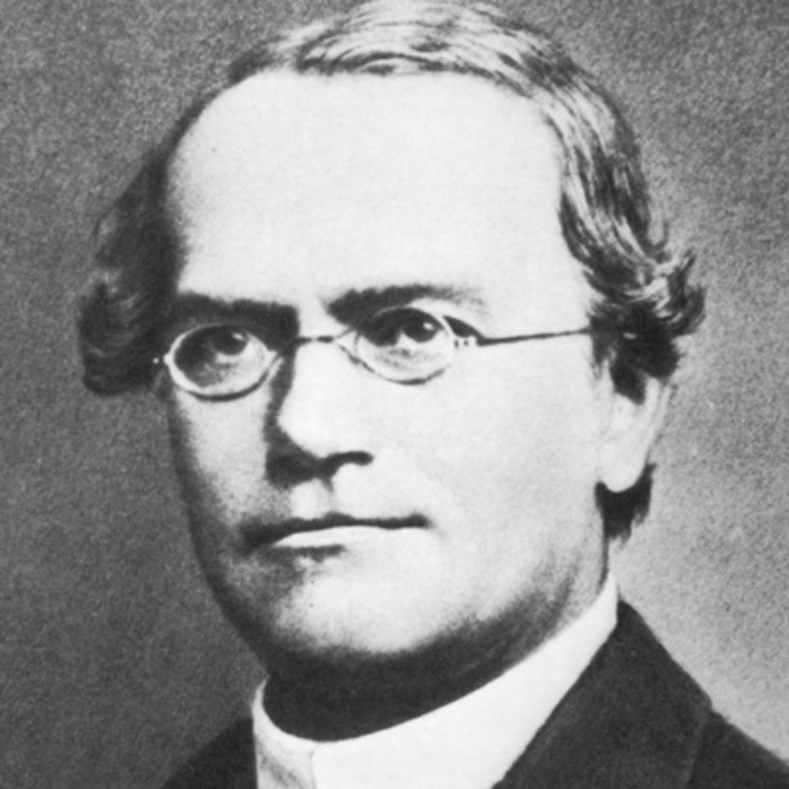
Inheritance
Who is this?

Slide 13
Inheritance
Gregor Mendel – Austrian monk who developed the Patterns of Inheritance Theory using pea plants
  Inheritance involves reshuffling of genes from generation to generation

Slide 14
Inheritance
Mendel used a technique involving pure-breeding pea plants that displayed particular traits (tall or short, round pods or wrinkled pods, green pods or yellow pods)
Then cross-bred tall and short plants and grew the resulting seeds.
Found that all offspring were tall…..
Notes:
Why pea plants? They are perfect as they have no intermediate forms (eg medium height or greeny-yellow pods), and they self pollinate meaning they are all pure-bred.

Slide 15
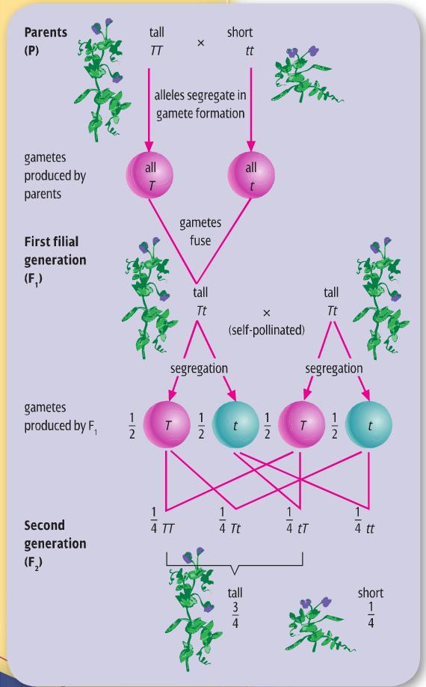
Inheritance
Mendel had used Monohybrid crosses and discovered dominant and recessive traits.
Parent (P) generation all consisted of homozygous alleles
F1 generation resulted in all heterozygous alleles
F2 generation then had the opportunity to be any assortment of alleles

Slide 16
Complete, Incomplete/Partial, Co-dominance
Not all genes that are coded for are presented as Mendel had discovered them. He investigated complete dominance where one allele is dominant over another
Inheritance however, is not as straight forward

Slide 17
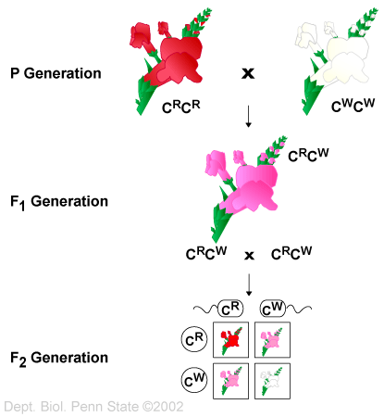
Incomplete or Partial Dominance
On trait is not completely dominant over the other
EG Red Snapdragons (C^{R}) and white Snapdragons (C^{W}) breed together can create pink (C^{R}C^{W})

Slide 18
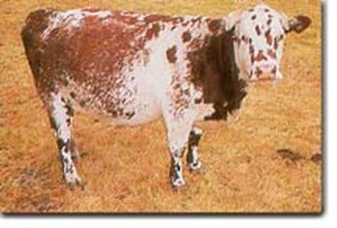
Codominance
Both traits are dominant, therefor characteristics of both traits are displayed in phenotype.
EG White cattle (C^{W}C^{W}) and Red cattle (C^{R}C^{R}) can result in Roan offspring (C^{W}C^{R}).

Slide 19
Incomplete dominance
A cross between a blue blahblah bird & a white blahblah bird produces offspring that are silver. The color of blahblah birds is determined by just two alleles.
What are the genotypes of the parent blahblah birds in the original cross?
What is/are the genotype(s) of the silver offspring?
What would be the phenotypic ratios of offspring produced by two silver blahblah birds?
The color of fruit for plant "X" is determined by two alleles. When two plants with orange fruits are crossed the following phenotypic ratios are present in the offspring: 25% red fruit, 50% orange fruit, 25% yellow fruit. What are the genotypes of the parent orange-fruited plants?

Slide 20
Multiple Alleles
More than two types for a gene.
Eg Blood types humans can have the alleles I^{A}, I^{B} or I
I^{A}, I^{B} are Codominant genes code for particular antigens on the surface of red blood cells.
i is recessive to both other types. It does not code for an antigen. This can also be called O blood group.
Find the possible blood types of offspring with parents:
  AB x AA
  AB x ii
  AA x BO

Slide 21
Blood types Practice questions
A man with Type O blood marries a woman with heterozygous Type A blood. What are the possible phenotypes of the children
A wealthy couple is killed when their yacht is sunk by a hurricane. They leave an estate of 5 million dollars. Six months after their death a man claims he is their long lost son. The man claiming to be their son has blood type A. The wealthy man is type A and his wife is type O. You are the judge. What do you do with the $5,000,000

