Slide 1
Pedigrees: a chart which can show trait inheritance through several generations
Albinism

Slide 2
Symbols
mating
Male
Female

Slide 3
More symbols
She gave birth!

Slide 4
Even more symbols
… 4 children!

Slide 5
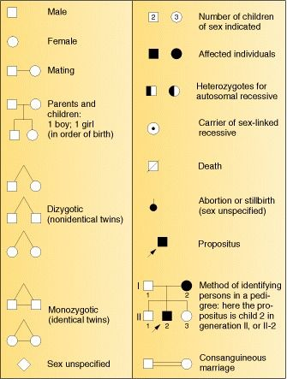
Still more symbols

Slide 6
Albinism – recessive disorder
aa
Aa
aa
aa
Aa
Aa

Slide 7
Deafness – dominant disorder
aa
Aa or AA?
Mother must be AA.
Aa
Aa
Aa
Aa

Slide 8
Colored blindness – Sex linked
X^{c}Y
X^{C}X^{c}
X^{c}Y
X^{C}X^{c}
X^{C}Y
X^{c}X^{c}

Slide 9
Pedigree of Lewis family
Me!

Slide 10
Questions on Pedigree Analysis – answer the question and explain why.

Slide 14
