Slide 1
The Excretory System

Slide 2
The role of the excretory system
The excretory system is a system of organs that is responsible for removing waste products from the body. The accumulation of waste products can be dangerous and must be removed the body.
Body System | Main Organs | Waste Products Removed
Urinary System | Kidneys | Urea, uric acid and water.
Respiratory System | Lungs | Water vapour
Digestive System | Stomach, small and large intestines | Faeces
- | Skin | Salts, water small amounts of urea

Slide 3
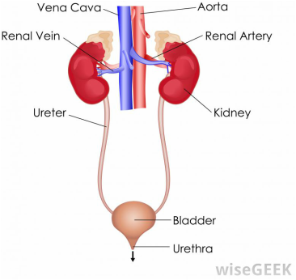
Urinary System: Main Organs
Kidneys- Blood is filtered in the kidneys by filtering units (nephrons).
Nephrons- Filter impurities out of the blood (urea, mineral salts and other toxins), leaving the necessary substances to return into the blood stream (water, glucose and any other nutrients.)
Ureters- Tube that carries urine from a kidney to the urinary bladder
Urinary Bladder- The duct that leads from the urinary bladder to outside of the body.

Slide 4
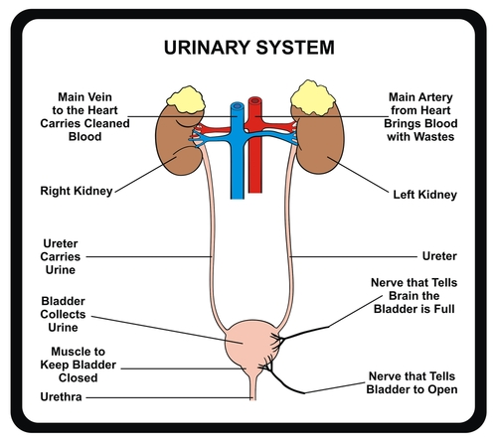

Slide 5
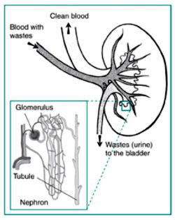
The Nephron
Nephrons are filtering structures in the kidneys
Nephrons help: -Remove excess water and wastes from your blood. -Return substances like sodium, potassium or phosphorus to the blood when required.

Slide 6
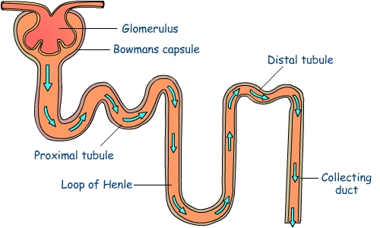
The Nephron
Contains juxtaglomerular cells which are involved in the release of renin, a hormone involved in the regulation of blood pressure.
Bowmans capsule- A double-walled, cup-shaped structure that surrounds the glomerulus. Made of epithelial tissues.
Glomerulus – small blood vessel that is responsible for filtering the blood. This acts like a sieve to remove waste.
Distal Tubule- The distal tubule connects the loop of Henle to the collecting duct system that passes urine to the ureters.
Proximal Tubule- the curvy first section of the renal tubule. The tubule cells that line the proximal convoluted tubule reabsorb much of the water and nutrients initially filtered into the urine.
Collecting Duct/Renal Tubule- wastes and recyclables pass through here once filtered from the glomerulus. Urine is passed to the ureters and recyclables are released back into the blood when required.
Loop of Henle- long, straight, tubular segment connecting the proximal tubule to the distal convoluted tubule and lies parallel to the collecting ducts.

Slide 7
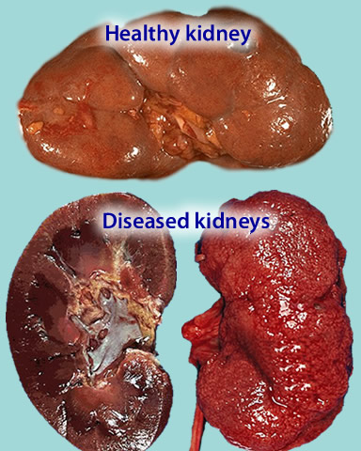
Kidney malfunction
Kidney disease occurs due to damage to the kidneys and leads to a build-up of waste products in the body over time. This is due to a decreased glomerular filtration rate.
Kidney disease can be caused by:
Ageing kidneys
Diabetes
High blood pressure
Symptoms include shortness of breath, high blood pressure, dizziness, weakness, lethargy and abnormal heart rythmns.

Slide 8
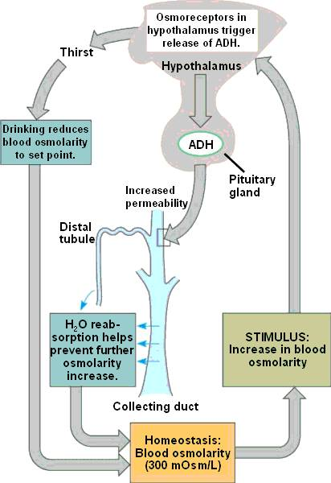
The interconnected nature of nature
The function of the urinary system is closely related to the circulatory system through the flow of blood around the body and specifically, to and from the kidneys
The endocrine system also works with the urinary system through the release of hormones to regulate kidney function. E.g Antidiuretic hormones are released when there is a decrease in blood volume and increase in blood osmolarity. This causes the kidneys to retain more water, producing concentrated urine.

